Slide 1

AWS Academy Cloud Web Application Builder
By
Sowmya Vara

Slide 2
Phase 1: Planning the design and estimating cost
Task 1: Creating an architectural diagram
Create an architectural diagram to illustrate what you plan to build.
Task 2: Developing a cost estimate
Develop a cost estimate that shows the cost to run the solution in the us-east-1 Region for 12 months. Use the AWS Pricing Calculator for this estimate.

Slide 3
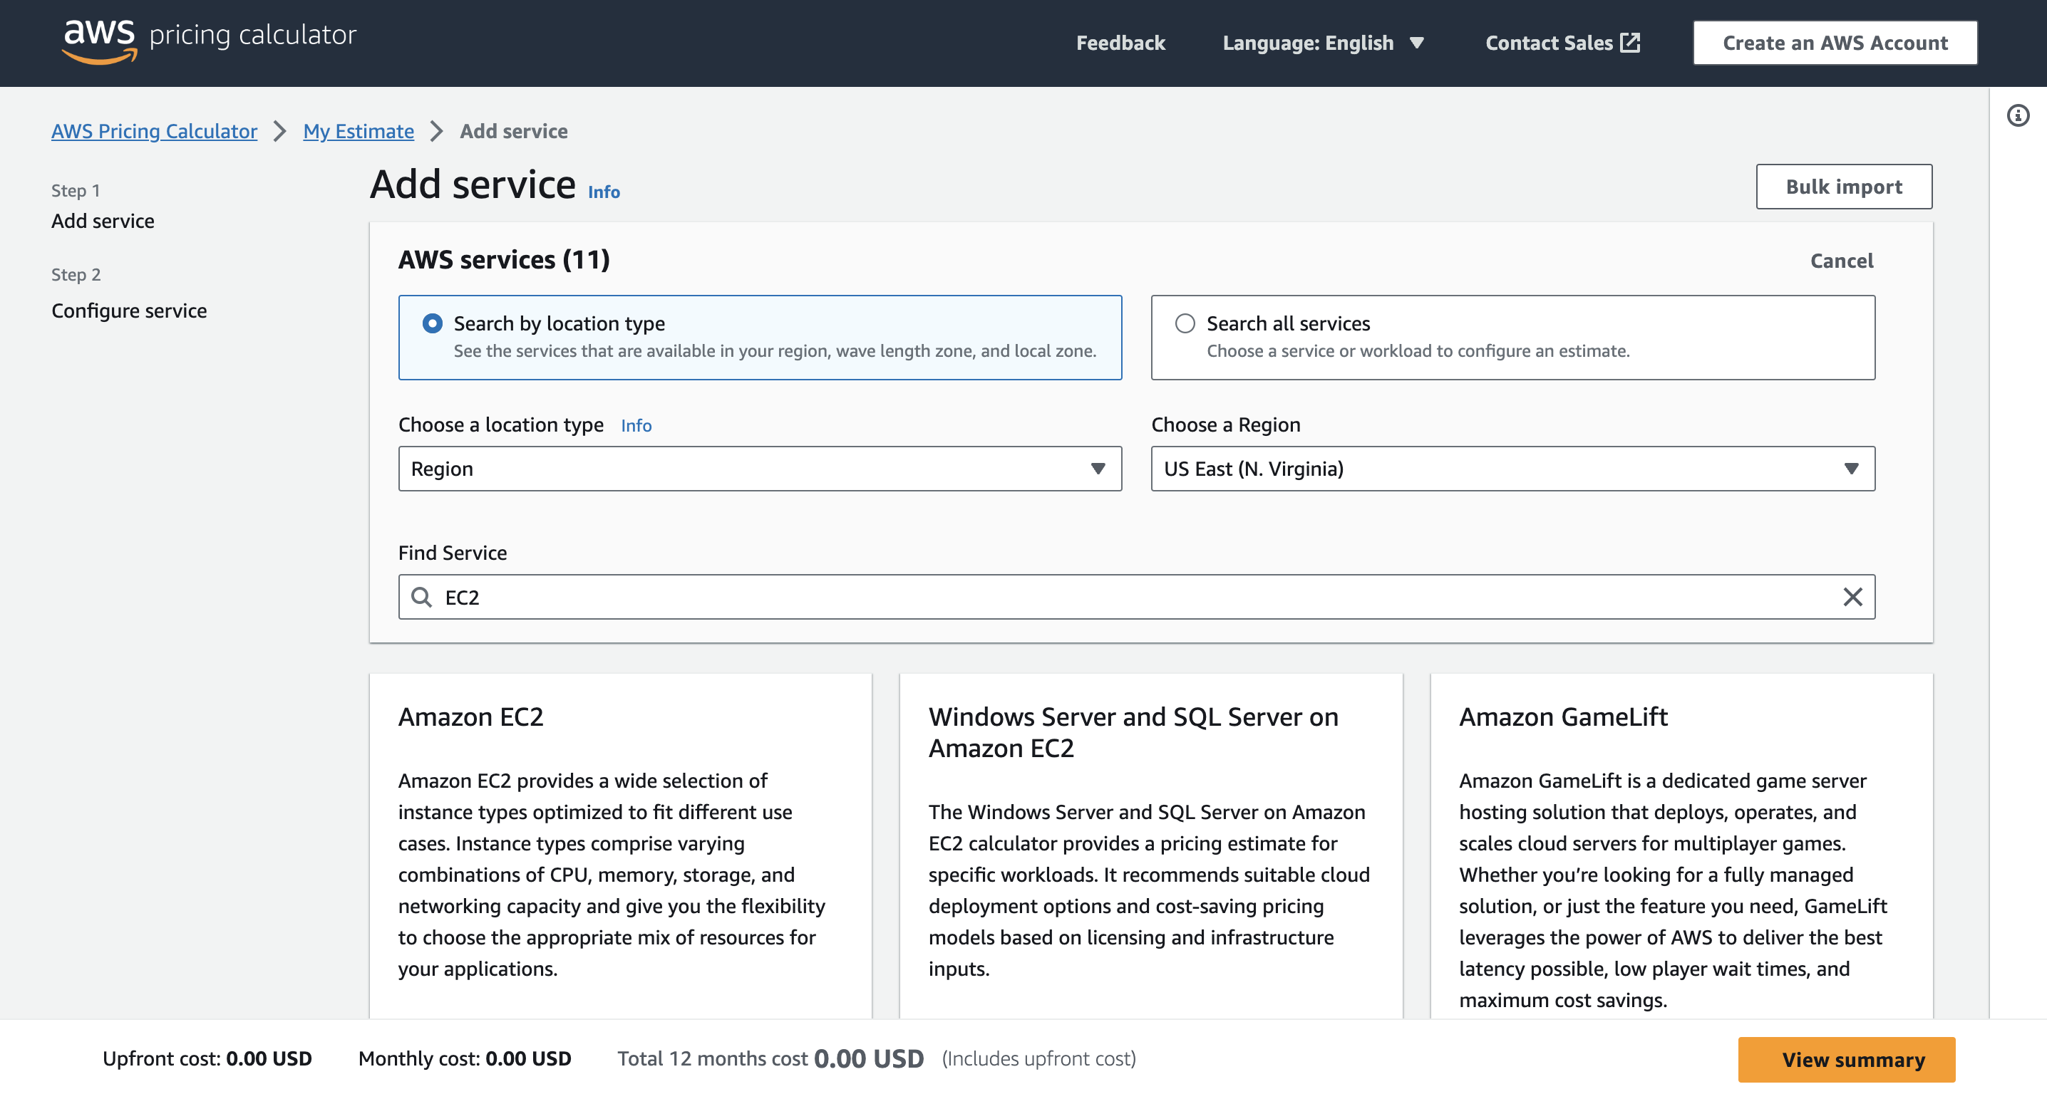

Slide 4
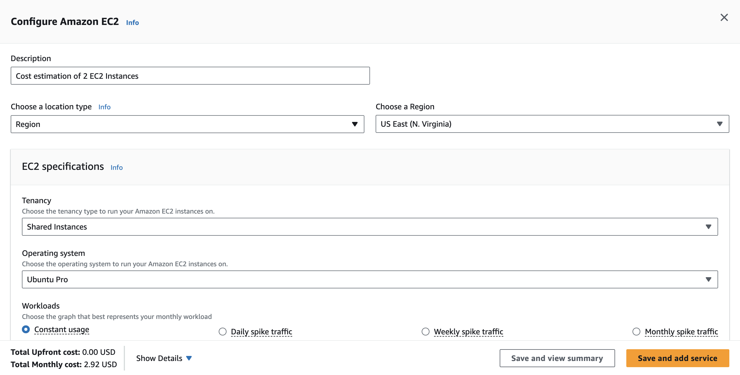

Slide 5
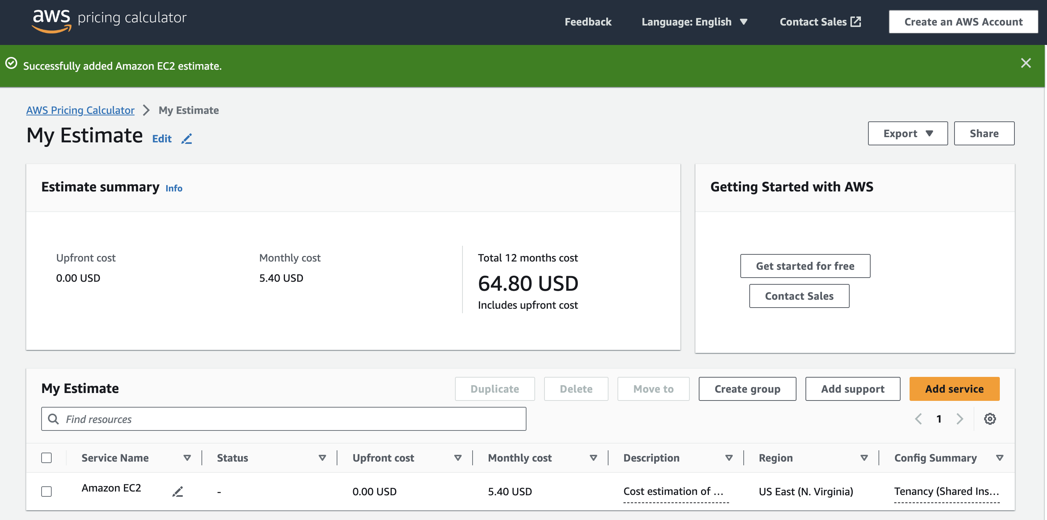

Slide 6
Phase 2: Creating a basic functional web application
Task 1: Creating a virtual network
Create networking resources such as a virtual private cloud (VPC) and subnets.
Reference
AWS Academy Cloud Architecting – Lab: Creating a Virtual Private Cloud

Slide 7
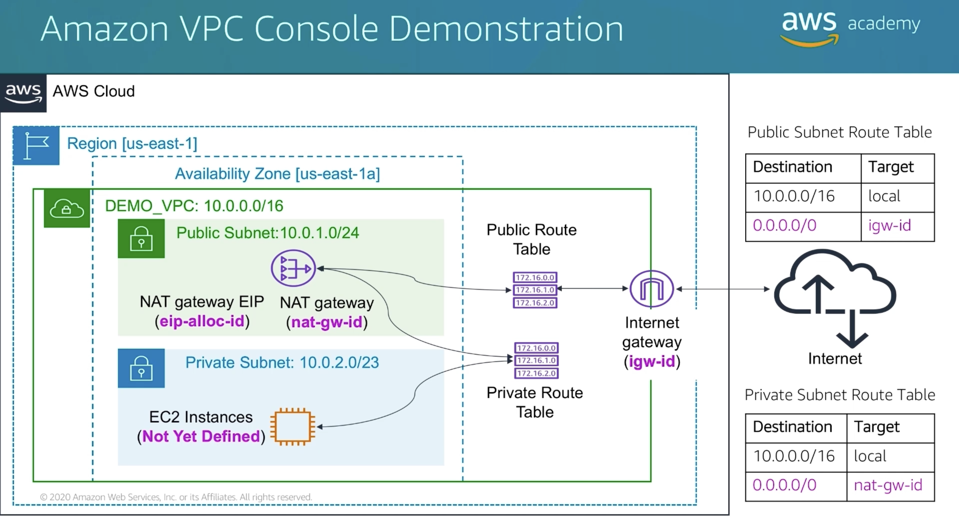

Slide 8
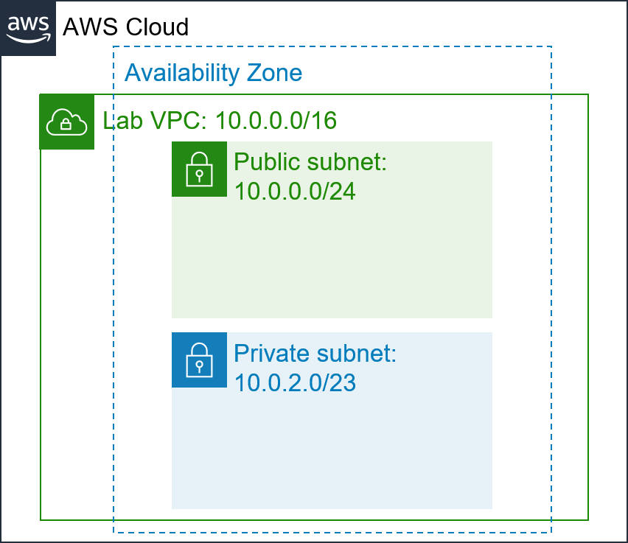
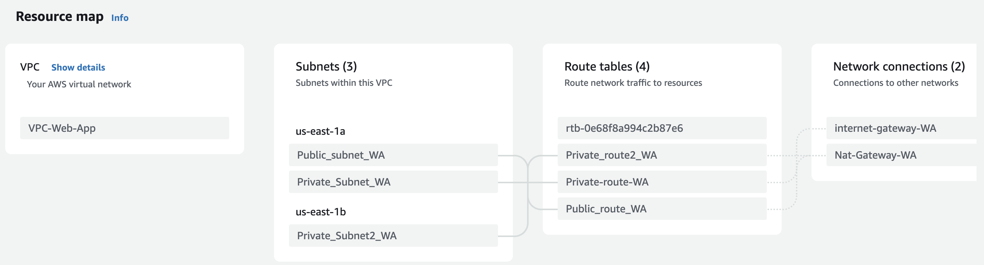
Public Subnet 10.0.1.0/24
Private Subnet 10.0.2.0/24
2
3

Slide 9
Phase 2: Creating a basic functional web application
Task 2: Creating a virtual machine
Create a virtual machine in the cloud to host the web application.
To install the required web application and database on the virtual machine, use the JavaScript code from the following link: SolutionCodePOC
Tips:
Use a compute service such as Amazon Elastic Compute Cloud (Amazon EC2).
Use the latest Ubuntu Amazon Machine Image (AMI).

Slide 10
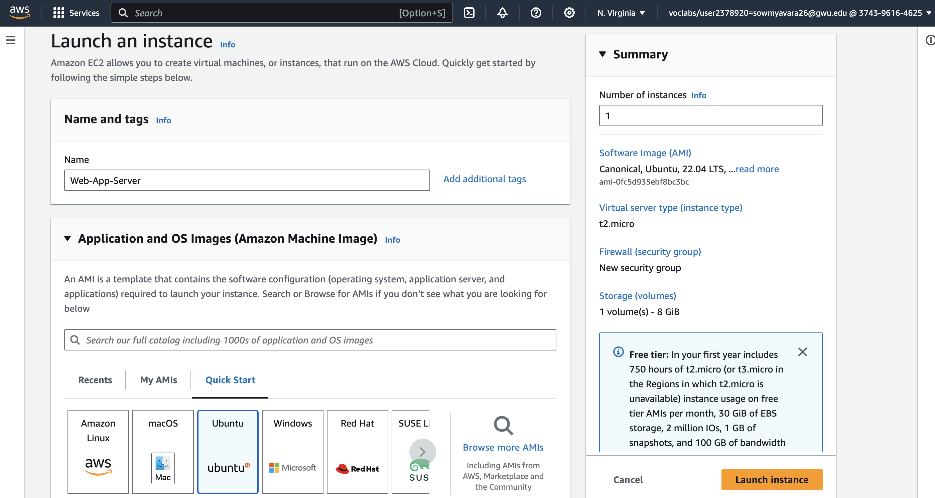
EC2 > Instances > Launch an Instance

Slide 11
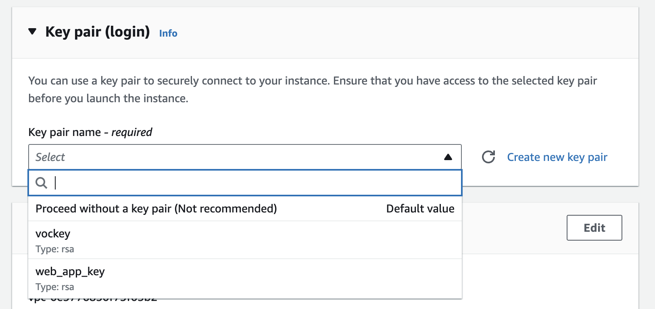
If created a new key pair, Please Download it and Keep it safe!

Slide 12
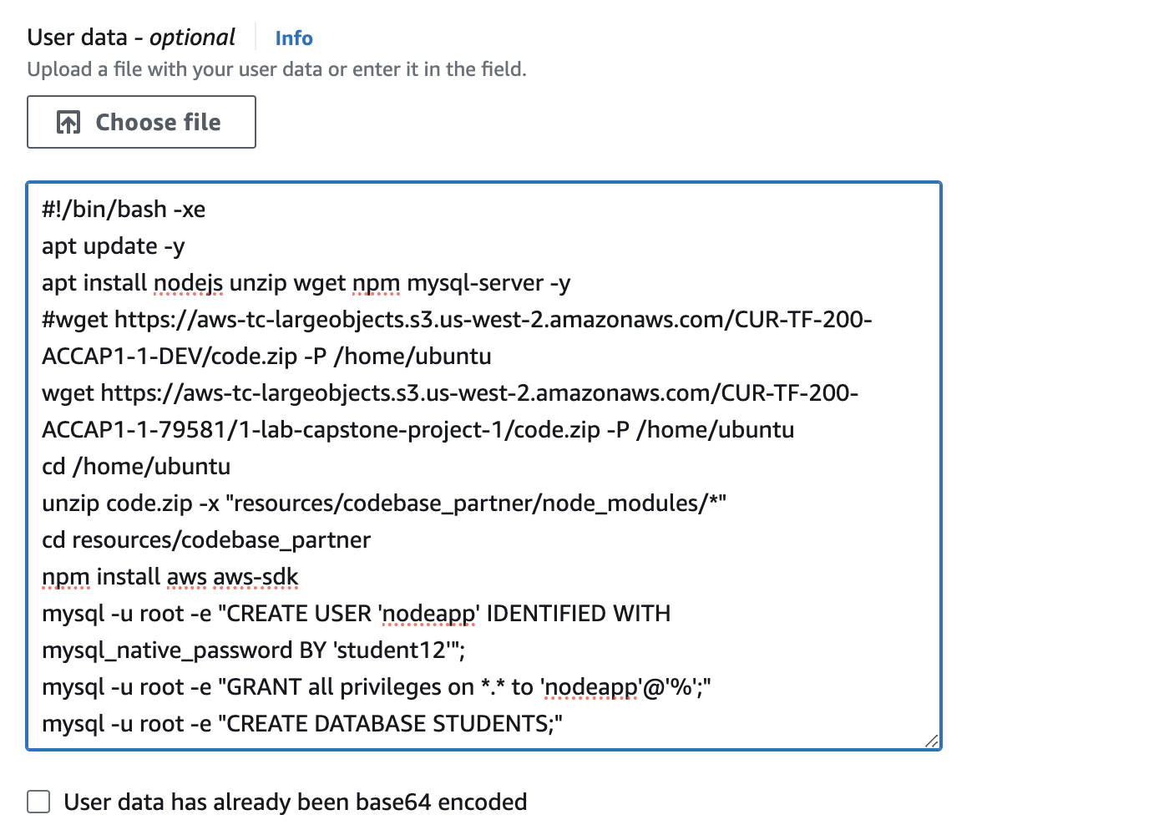
Copy the Script
UserdataScript-phase-2.sh
(Download it by clicking on
SolutionCodePOC)
And paste it in User data.
Launch Instance after configuring.

Slide 13
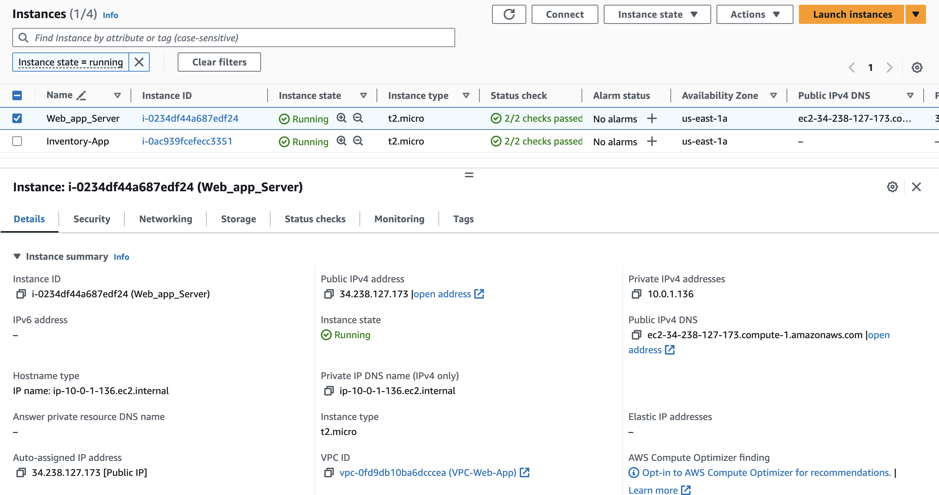

Slide 14
Phase 2: Creating a basic functional web application
Task 3: Testing the deployment
Test the deployment of the web application to ensure it is accessible from the internet and functional. Perform a few tasks, such as viewing, adding, deleting, or modifying records.
Tip: To access the web application, use the IPv4 address of the virtual machine.

Slide 15
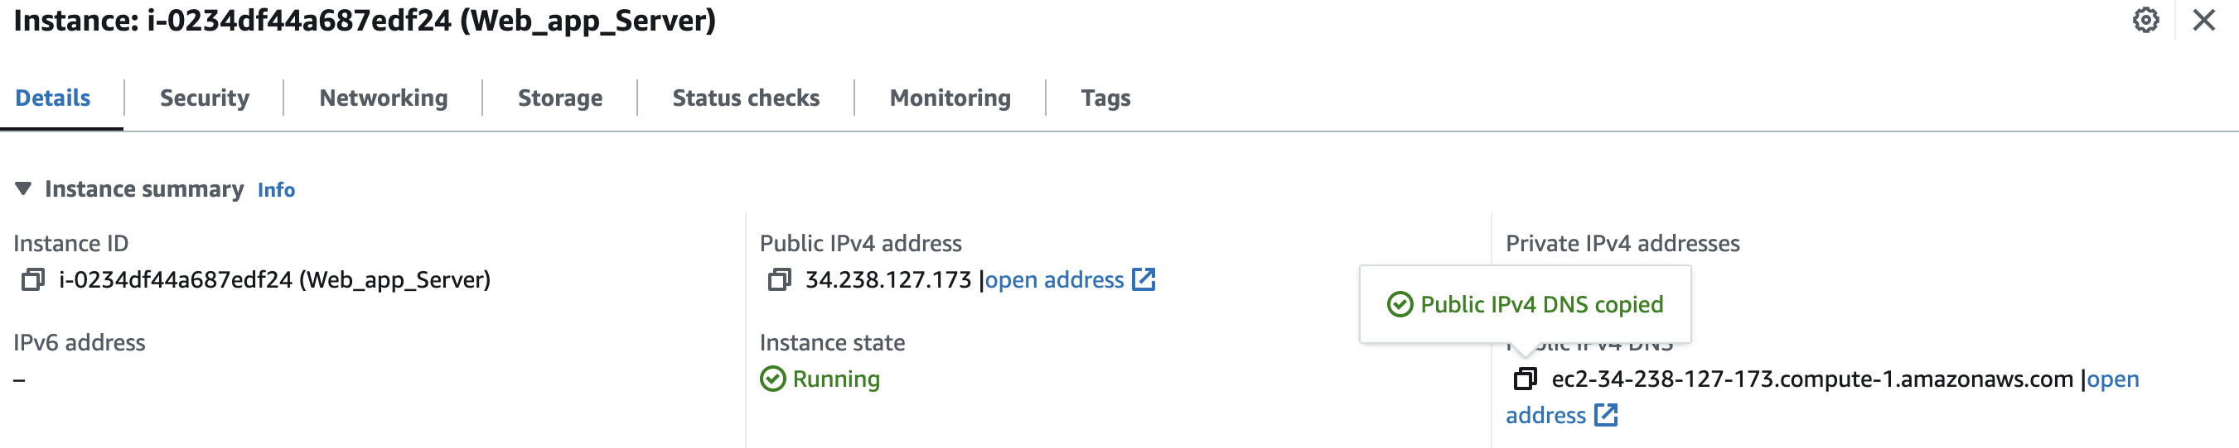
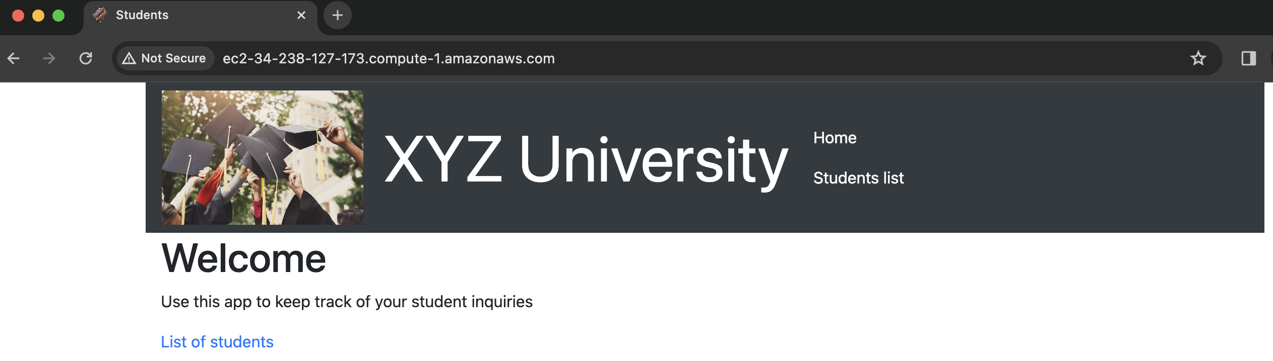

Slide 16
Phase 3: Decoupling the application components
Task 1: Changing the VPC configuration
Update or re-create the virtual network components that are necessary to support hosting the database separately from the application.
Note: You need private subnets in a minimum of two Availability Zones.
Reference
AWS Academy Cloud Architecting – Lab: Creating a Virtual Private Cloud

Slide 17
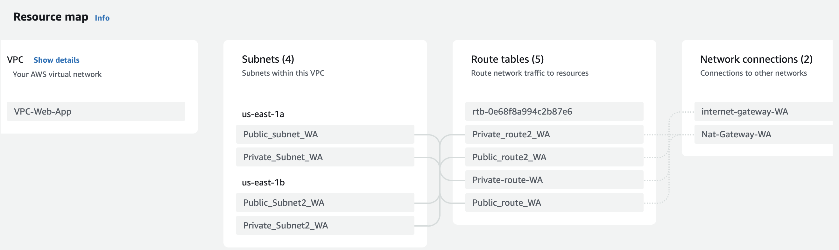

Slide 18
Phase 3: Decoupling the application components
Task 2: Creating and configuring the Amazon RDS database
Create an Amazon Relational Database Service (Amazon RDS) database that runs a MySQL engine. You can choose to create a provisioned instance or run it serverless.
Notes:
Allow only the web application to access the database.
Don't enable enhanced monitoring.
Reference
AWS Academy Cloud Foundations – Lab: Build Your DB Server and Interact With Your DB Using an App

Slide 19
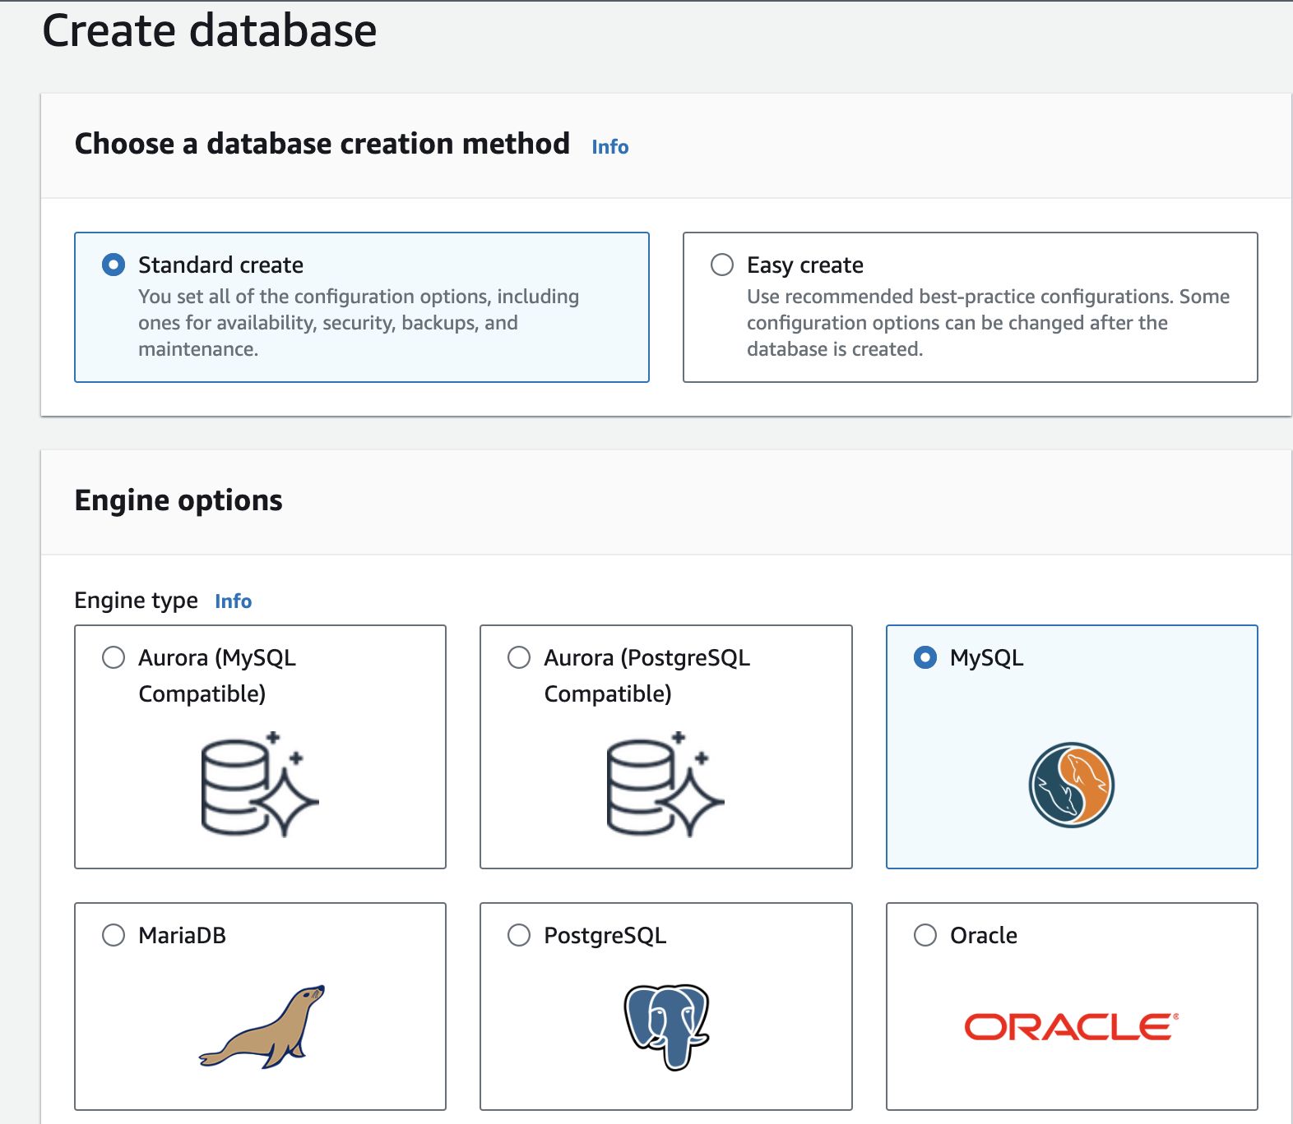
RDS > Database

Slide 20
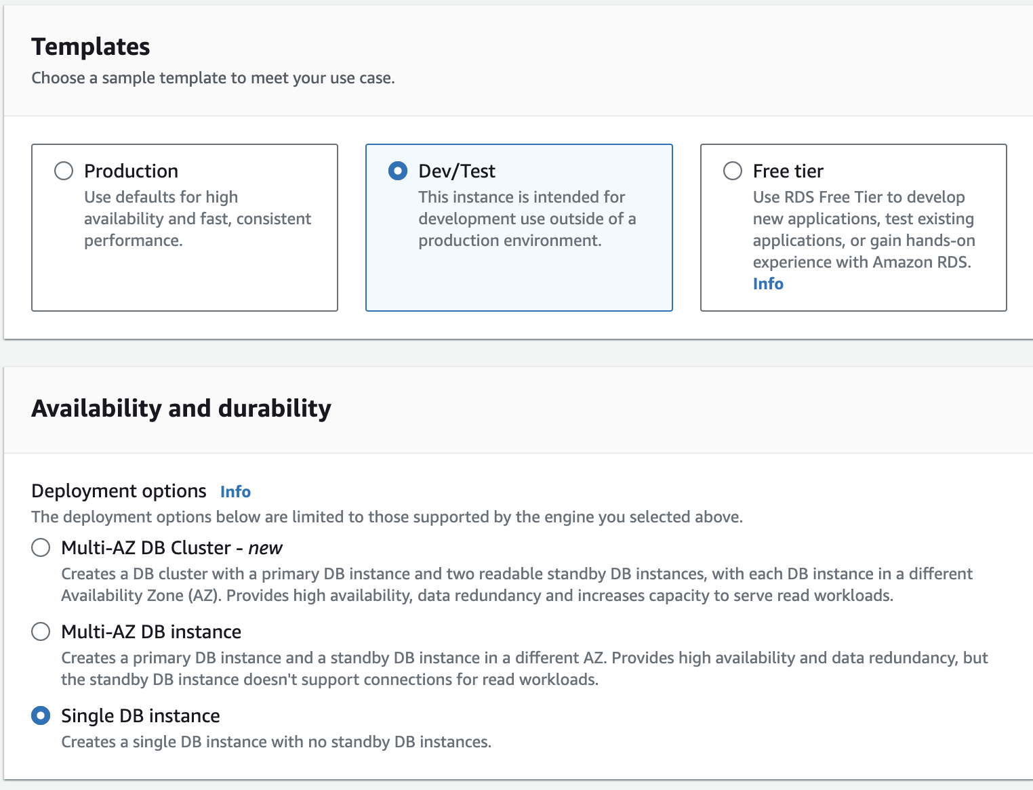
Please do click on Single DB instance
Instead of Multi-AZ DB instance
In Credential Settings
Enter your
Master Username
Master Password
After Creating the RDS instance open it and copy and save the Endpoint in the Details tab.

Slide 21
Phase 3: Decoupling the application components
Task 3: Configuring the development environment
Provision an AWS Cloud9 environment to run AWS Command Line Interface (AWS CLI) commands in later tasks.
Notes:
Use a t3.micro instance for the AWS Cloud9 environment.
Use Secure Shell (SSH) to connect to the environment.
Reference
Creating Cloud9 Environment

Slide 22
Steps to Create Cloud9 Environment
Go to AWS Cloud9 Services
Click on Environments
Choose Create Environment
Enter the Name and Description
Select New EC2 instance for Cloud9 Environment
Instance Type is t3.micro
For the platform choose Ubuntu Server
Not Amazon Linux
In Network Settings:
Choose SSH connection

Slide 23
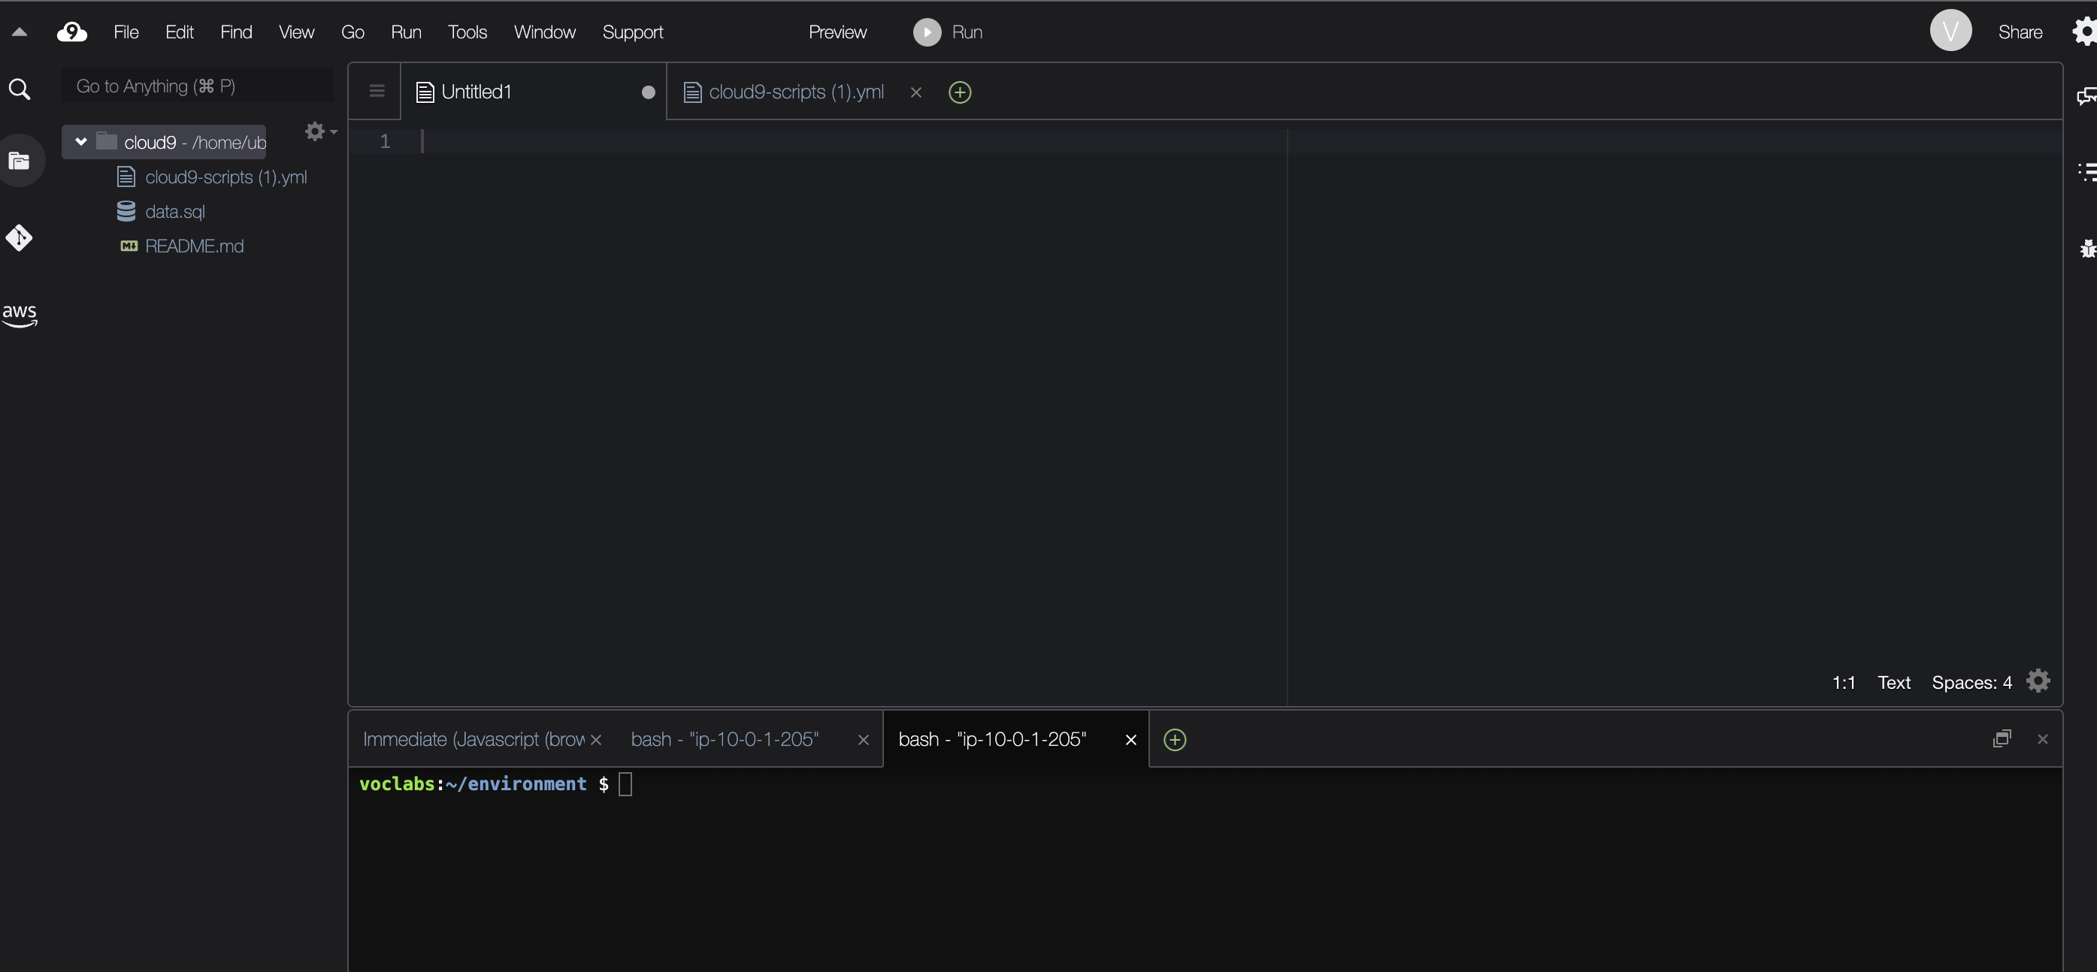

Slide 24
Phase 3: Decoupling the application components
Task 4: Provisioning Secrets Manager
Use AWS Secrets Manager to create a secret to store the database credentials, and configure the web application to use Secrets Manager.
Use Script-1 from the following link to create a secret in Secrets Manager by using the AWS CLI: AWS Cloud9 Scripts
Note: This .yml file also contains scripts that you will use in later tasks.
Reference
create-secret in the AWS CLI Command Reference for AWS Secrets Manager

Slide 25
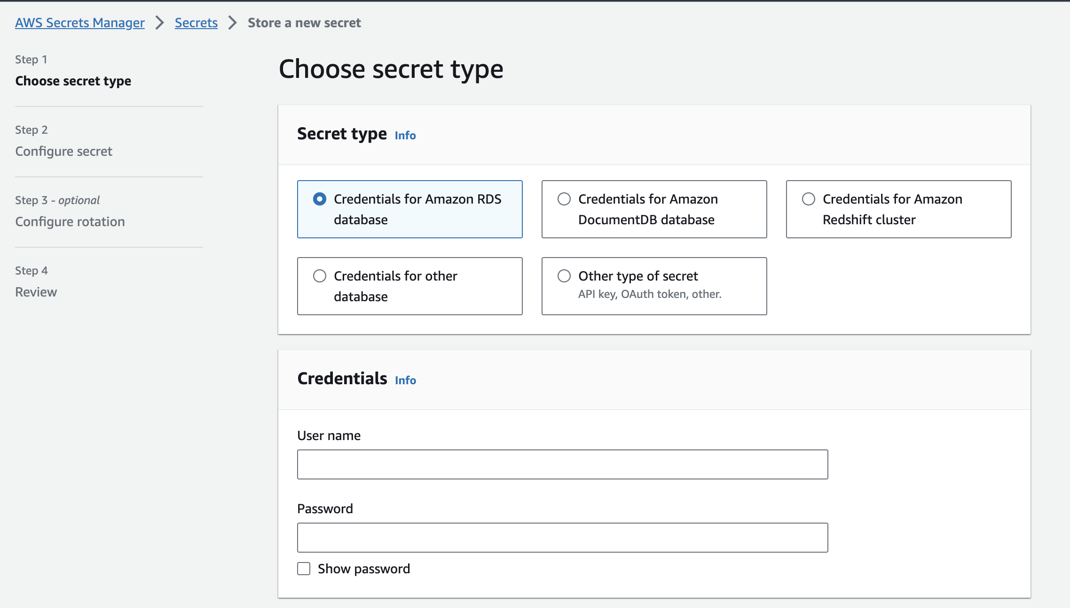
AWS Secrets Manager
Choose Credentials for Amazon RDS database
Give the saved Master Username and Master Password
Associate with the respective RDS database.

Slide 26
Cloud9
Script-1:
# Use following script to create secret in secret manager for accessing your database via the web application
# Replace the values for below placeholders with the actual values you have used to configure the service
#<RDS Endpoint>
#<password>
#<username>
#<dbname>
aws secretsmanager create-secret \
--name Mydbsecret \
--description "Database secret for web app" \
--secret-string "{\"user\":\"<username>\",\"password\":\"<password>\",\"host\":\"<RDS Endpoint>\",\"db\":\"<dbname>\"}"

Slide 27
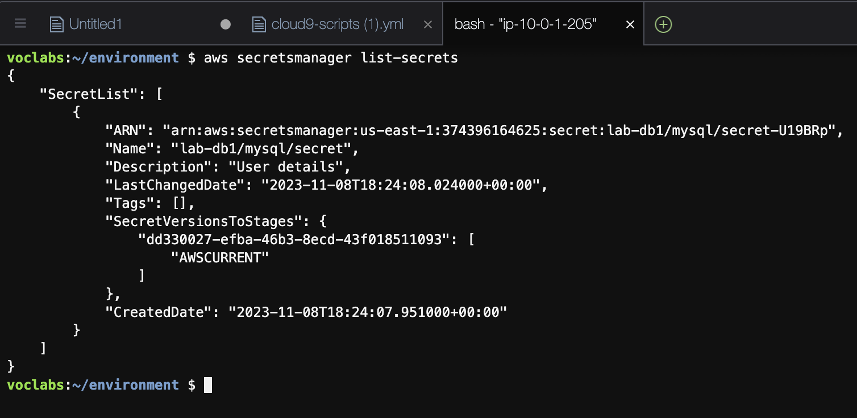
Cloud9

Slide 28
Phase 3: Decoupling the application components
Task 5: Provisioning a new instance for the web server
Create a new virtual machine to host the web application.
To install the required web application on the virtual machine, use the JavaScript code from the following link: Solution Code for the App Server
For the AWS Identity and Access Management (IAM) profile on the EC2 instance, attach the existing LabInstanceProfile profile. This profile attaches an IAM role called LabRole to the instance so that it can fetch the secret securely.
Note: Optionally, you can continue to use the existing virtual machine for the web application. However, you will need to reconfigure the application to connect to Amazon RDS.
Reference
AWS Academy Cloud Foundations – Lab: Build Your DB Server and Interact With Your DB Using an App

Slide 29
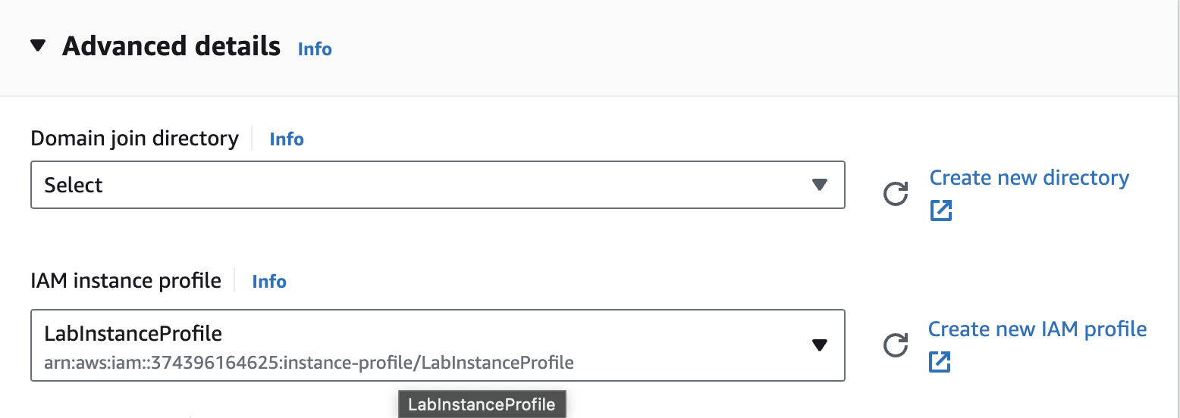
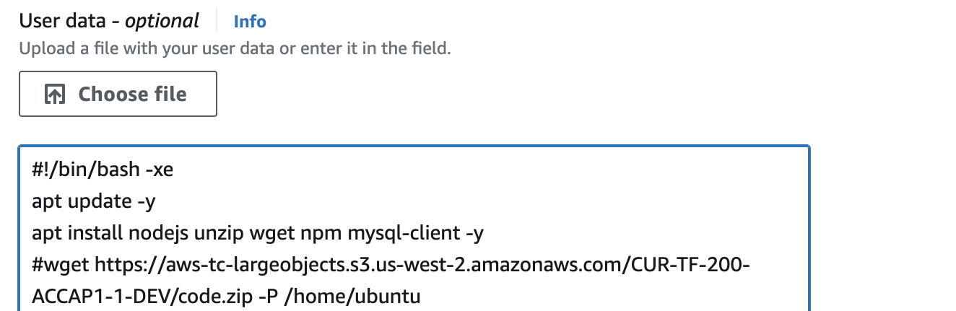
If creating a new EC2 instance, Choose IAM instance profile in Advanced details.
In the User data, give the UserdataScript-phase-3.sh script.

Slide 30
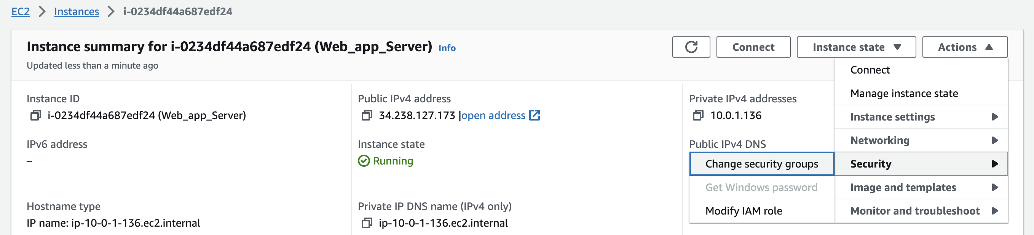
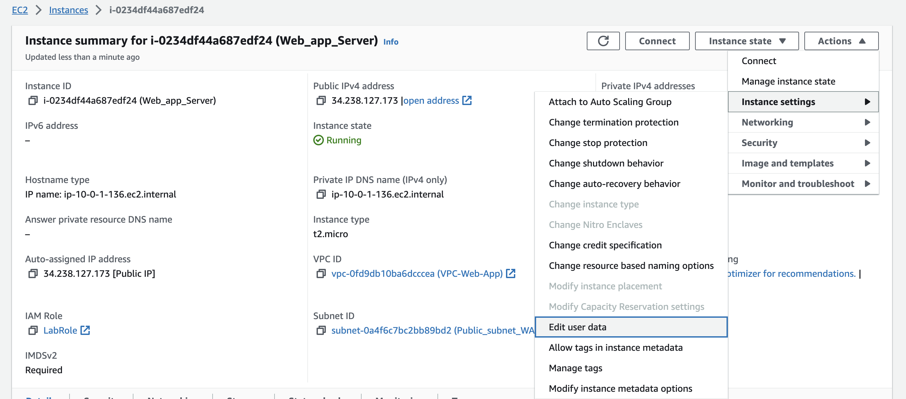
If updating the existing EC2 instance, go to Actions > Security > Modify IAM role
To modify the user data, go to Actions > Instance Settings > Edit user data

Slide 31
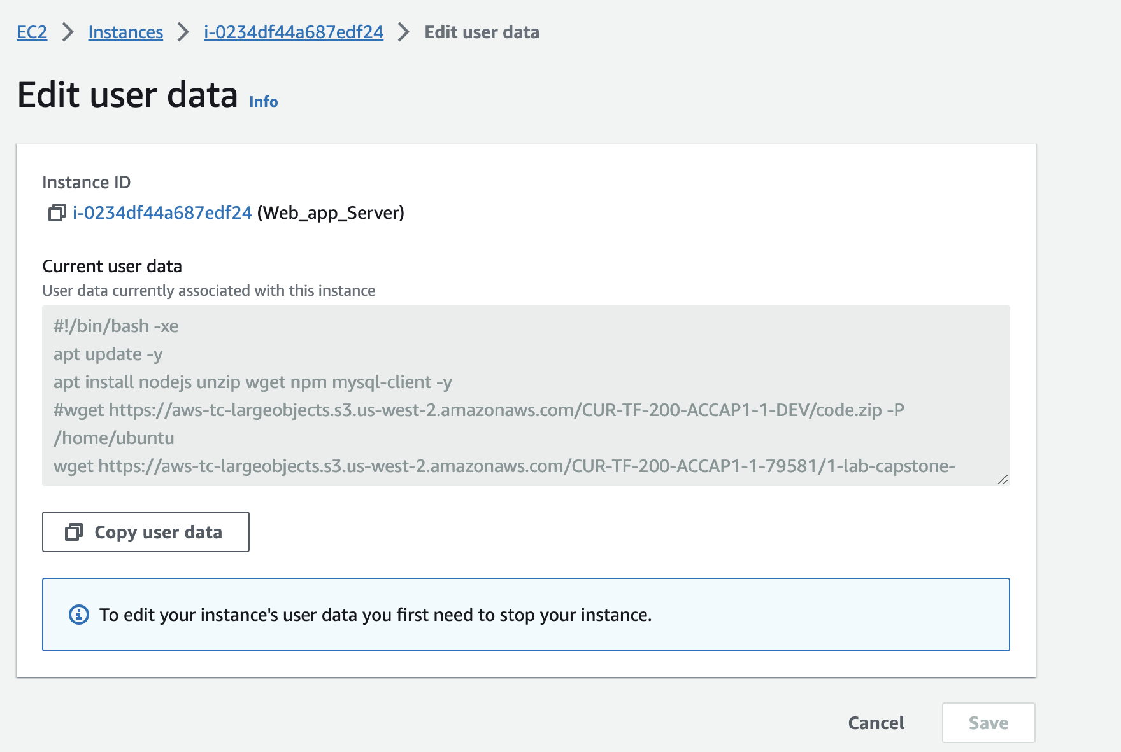

Slide 32
Phase 3: Decoupling the application components
Task 6: Migrating the database
Migrate the data from the original database, which is on an EC2 instance, to the new Amazon RDS database.
Use Script-3 from the AWS Cloud9 Scripts file (cloud9-scripts.yml) to migrate the original data into the Amazon RDS database. Recall that you used a script from this file earlier to create the secret in Secrets Manager.
Reference
AWS Academy Cloud Architecting – Lab: Migrating a Database to Amazon RDS

Slide 33
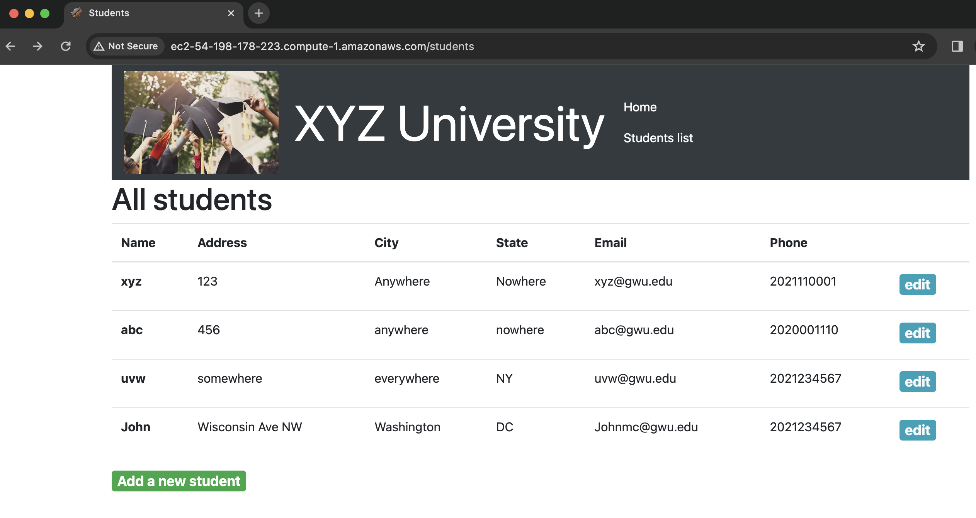
Web Application
Try to Edit the Student lists.
Add or remove the students.

Slide 34
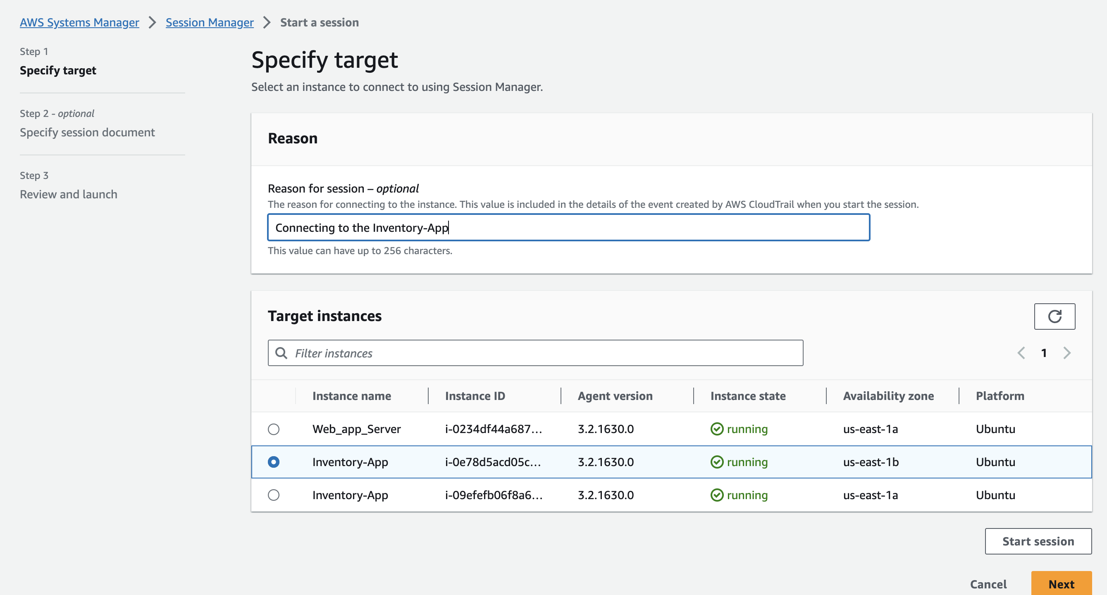
AWS Systems Manager

Slide 35
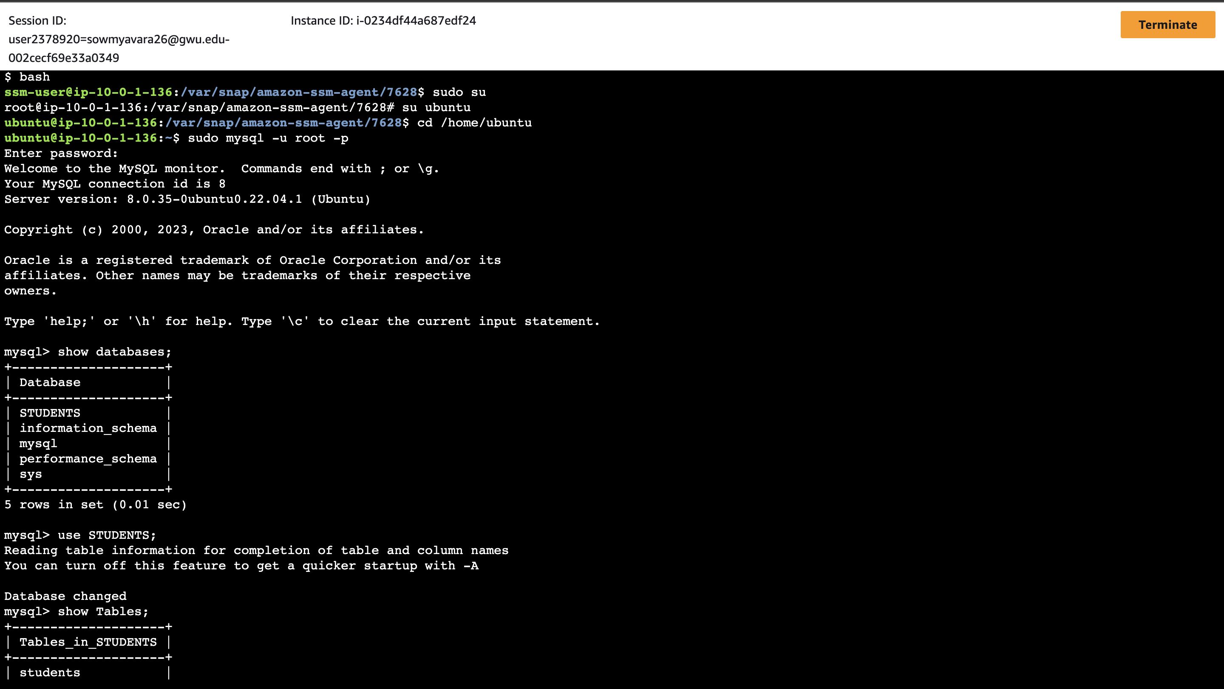
In the Prompt:
bash
sudo su
su ubuntu
whoami
cd /home/ubuntu/
Observe details of the database that runs on the EC2 instance.
service lab-db1 status
mysql –version
To connect to the terminal-based MySQL client to the database run this command:
mysql -u root –p
When prompted for the database password, enter the password.
Then run this command to see the available databases: show databases;

Slide 36
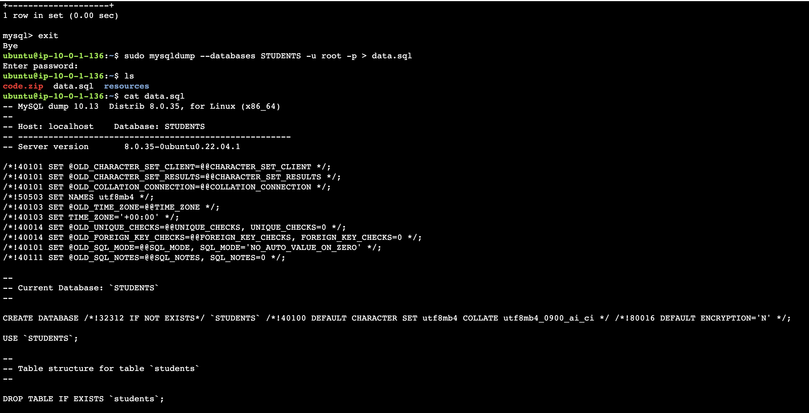
Exit the SQL client. -> exit;
Capture existing data in a file by using the mysqldump utility.
mysqldump --databases db-name -u root -p > data.sql
Confirm that mysqldump succeeded.
Run the ls command in the terminal. The output should show that the data.sql file was created.
Run the cat data.sql command to see the contents of the file.

Slide 37
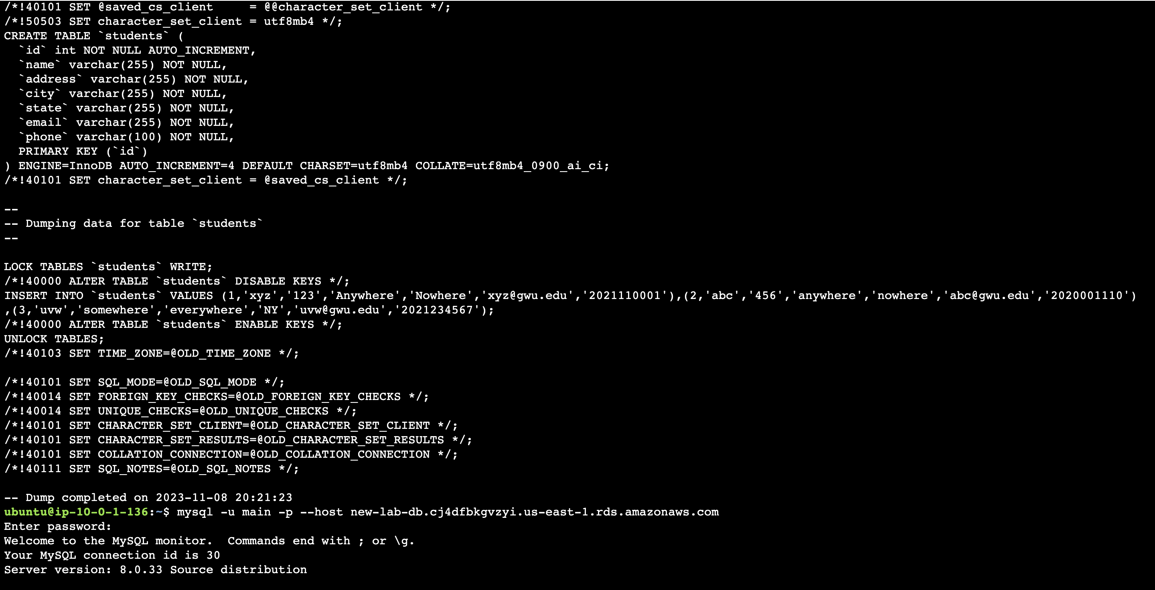
After successfully dumping the data, open MySQL again.

Slide 38
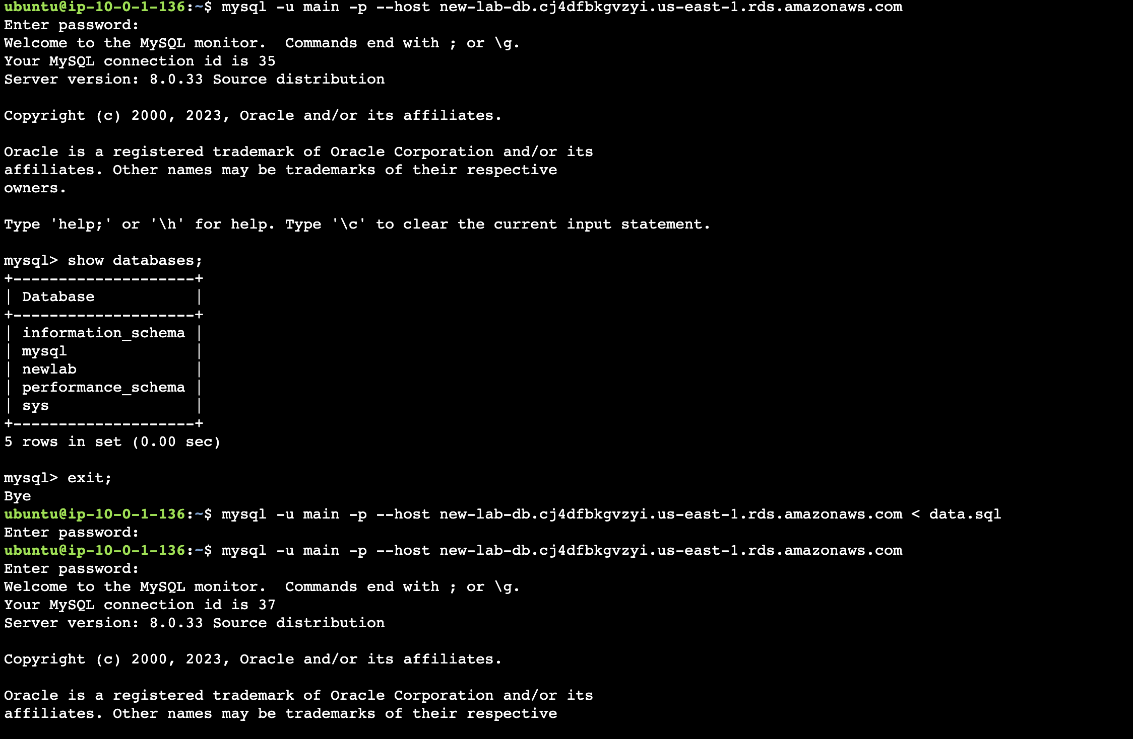
Run the show databases; command.
Notice that STUDENTS database is not in the list yet. This situation is expected, because you haven't imported any data.
(STUDENTS)
To disconnect, run the exit; command.
To import the data, in the terminal, run the following command (where <rds-endpoint> is the actual endpoint):
mysql -u admin -p --host <rds-endpoint> < data.sql

Slide 39
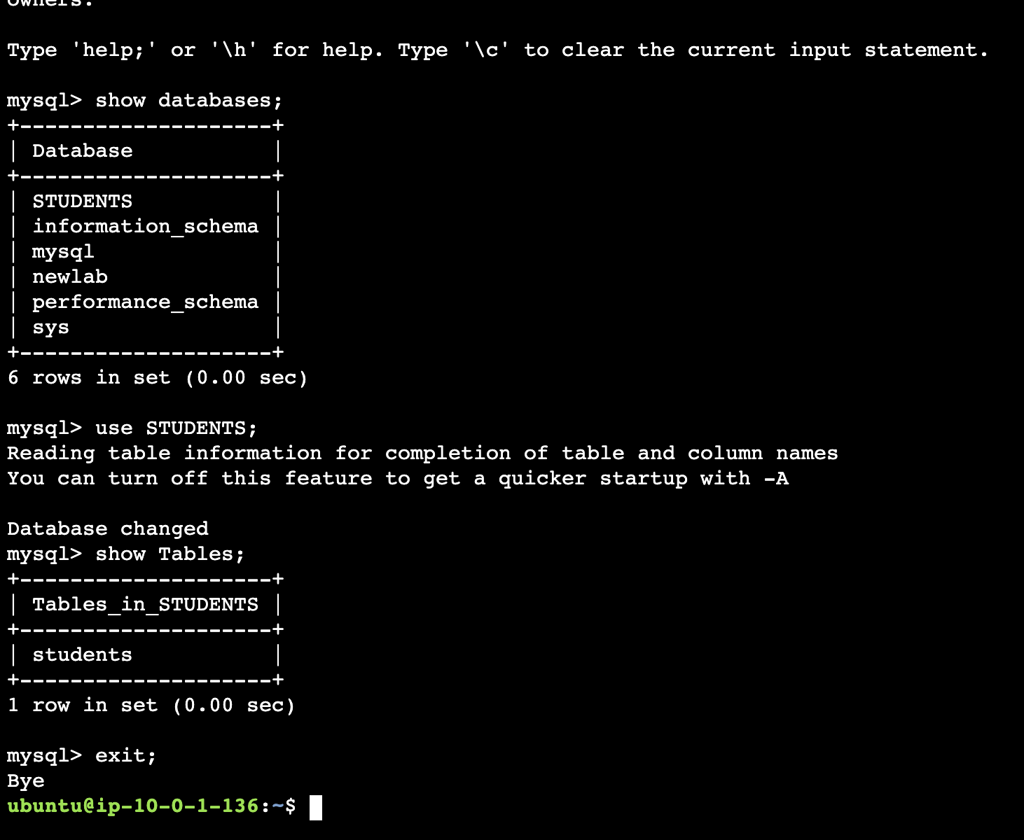
To connect to the RDS database, run this command:
mysql -u admin -p --host <rds-endpoint>
At the password prompt, enter the password for the RDS instance.
To confirm that the data was imported, run the following command:
show databases;
use STUDENTS;
show Tables;
To check if your web application working, try to add or remove students in student list page

Slide 40
Phase 3: Decoupling the application components
Task 7: Testing the application
Access the application and perform a few tasks to test it. For example, view, add, delete, and modify student records.

Slide 41
Phase 4: Implementing high availability and scalability
Task 1: Creating an Application Load Balancer
Launch a load balancer. The endpoint will be used to access your web application.
Tip: Use a minimum of two Availability Zones.
Reference
AWS Academy Cloud Architecting – Lab: Creating a Highly Available Environment

Slide 42
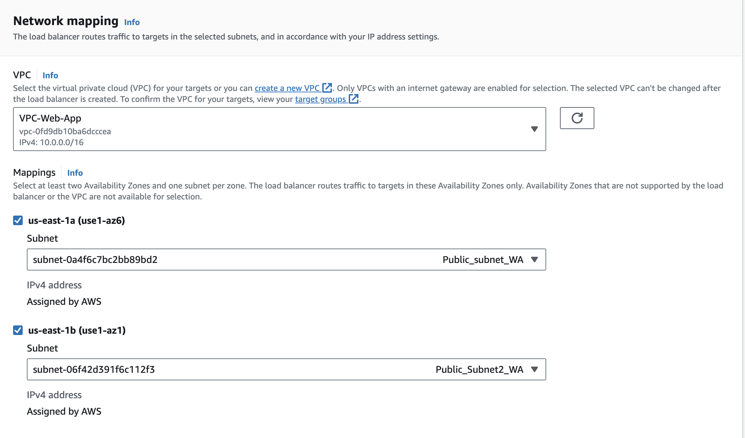
Creating a Load Balancer
EC2 > Load Balancers > Create Application Load Balancer
Assign a name to the Load balancer in Basic Configuration.
In Network Mapping, choose your VPC.
Under Mappings, choose first availability zone, then choose the Public Subnet.
Choose the second availability zone, then choose the public Subnet.

Slide 43
Creating a load Balancer
Click on Create a new Security Group in Security Group
Security group name: Inventory-LB
Description: Enable web access to load balancer
VPC: Remove the default VPC by choosing the X to the right of it. Then select your VPC.
Under Inbound rules, choose Add rule and configure as described:
Type: HTTP
Source: Anywhere-IPv4
Still under Inbound rules, choose Add rule again and configure:
Type: HTTPS
Source: Anywhere-IPv4
Choose Create security group.

Slide 44
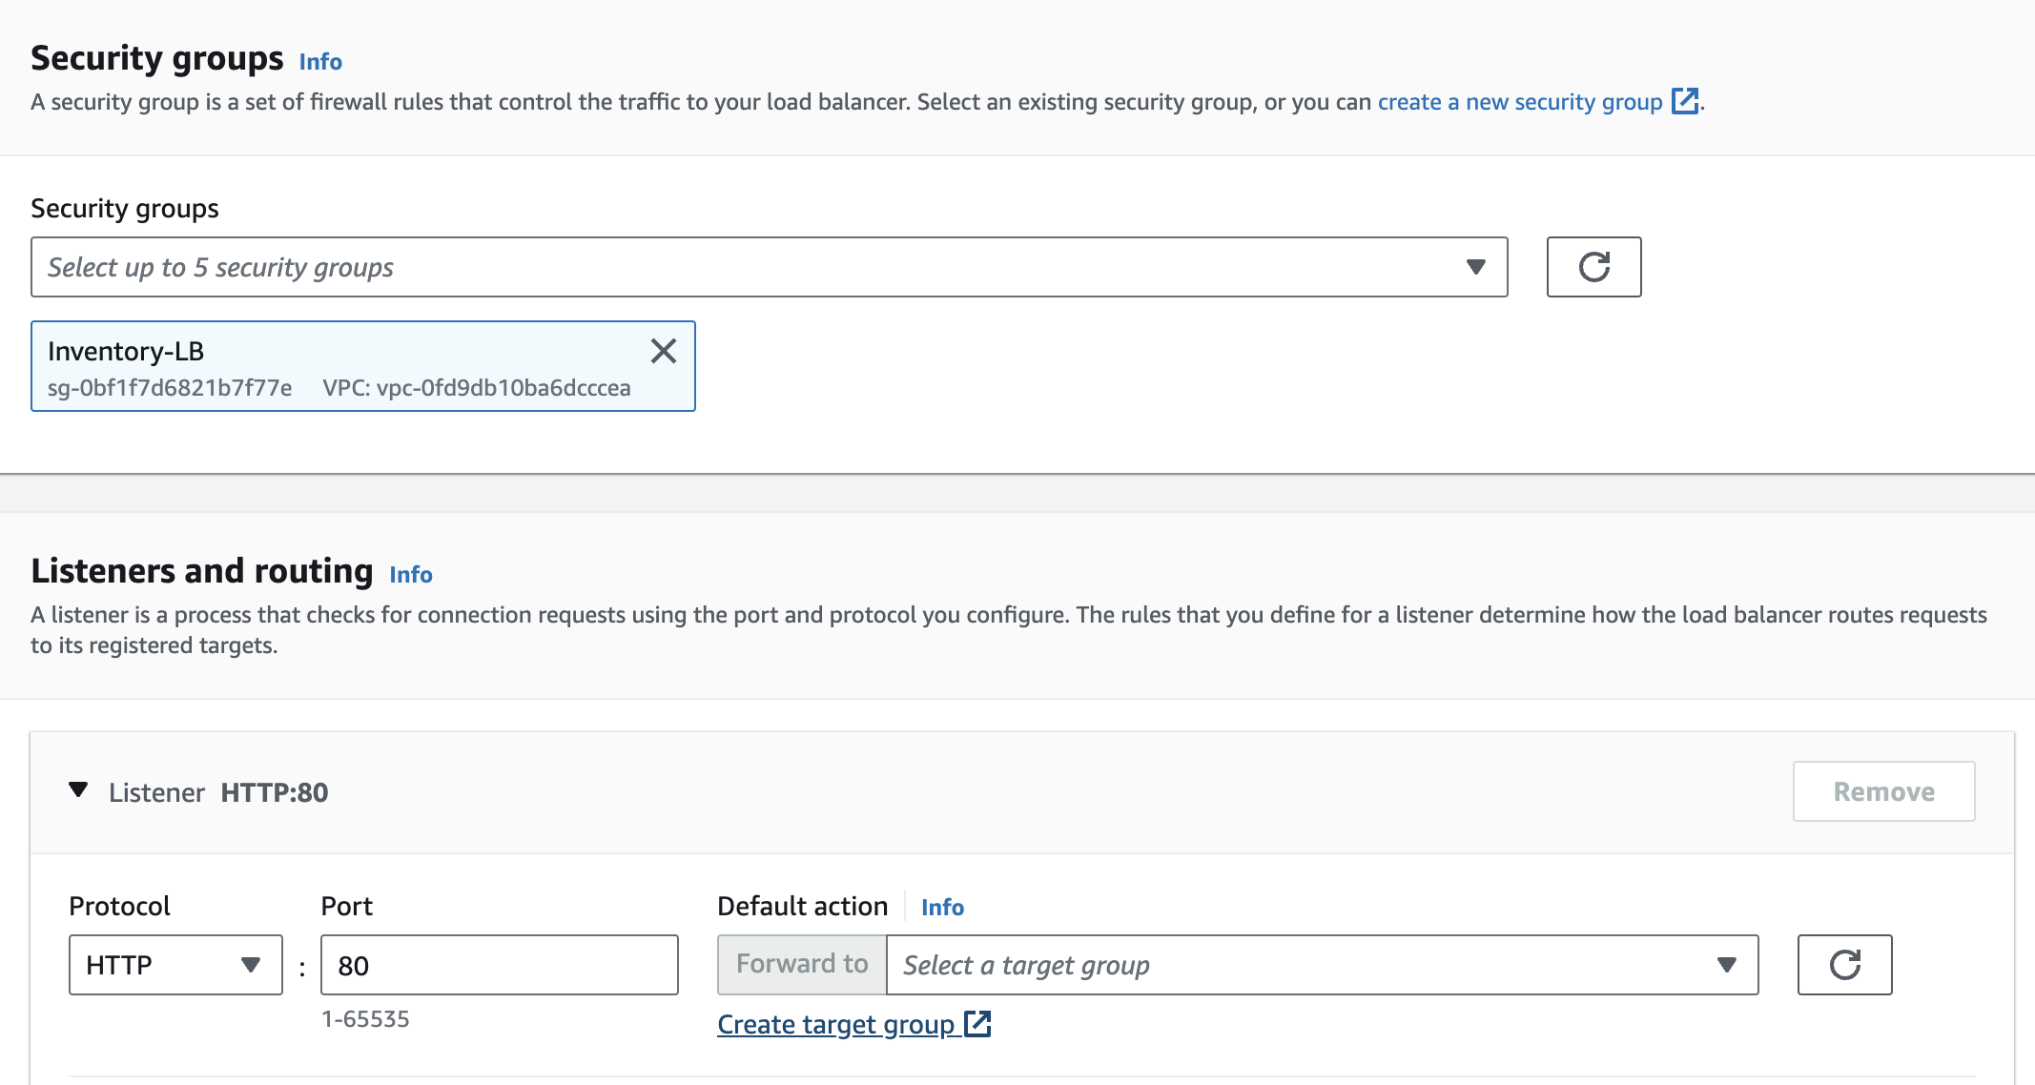
Creating a Load Balancer
After successful creation of security group, choose Inventory-LB under security groups in Creating load Balancer Tab.
Then under Listeners and routing, click on Create Target Group

Slide 45
Creating a Load Balancer
Configure the target group as described here:
Choose a target type: Instances
Target group name: Inventory-App
VPC: Ensure that your VPC is chosen.
Scroll down and expand Advanced health check settings.
Healthy threshold: 2
Interval: 10 (seconds)
The configurations you have chosen will result in the health check being performed every 10 seconds, and if the instance responds correctly twice in a row, it will be considered healthy.
Choose Next. The Register targets screen appears.
Note: Targets are the individual instances that will respond to requests from the load balancer.
You do not have any web application instances yet, so you can skip this step.
Review the settings and choose Create target group.
Now, in the Load Balancer tab choose the target group created and then Create the Load balancer.

Slide 46
Phase 4: Implementing high availability and scalability
Task 2: Implementing Amazon EC2 Auto Scaling
Create a new launch template, and use an Auto Scaling group to launch the EC2 instances that host the web application.
To accomplish this, you can create an AMI from the running instance, or create a new AMI and install the necessary packages and application code. Then, configure an Auto Scaling group to use the load balancer.
Tips:
Use a Target tracking policy.
Set the Auto scaling group size according to your estimated requirements.
You can use the default values (for example, for group size and CPU utilization) initially and then adjust them later as needed.
Reference
AWS Academy Cloud Architecting – Lab: Creating a Highly Available Environment

Slide 47
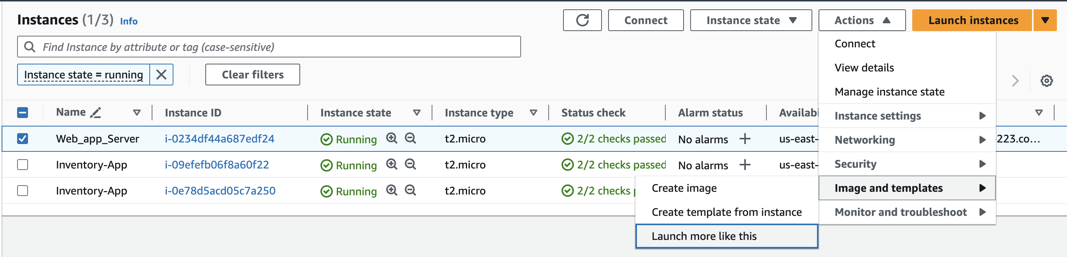
Creating Auto Scaling Group
EC2 instance > Actions > Image and template > Create image
Image name: Web Server AMI
Image description: Lab AMI for Web Server
Choose Create image
A banner at the top of the screen displays the AMI ID for your new AMI.

Slide 48
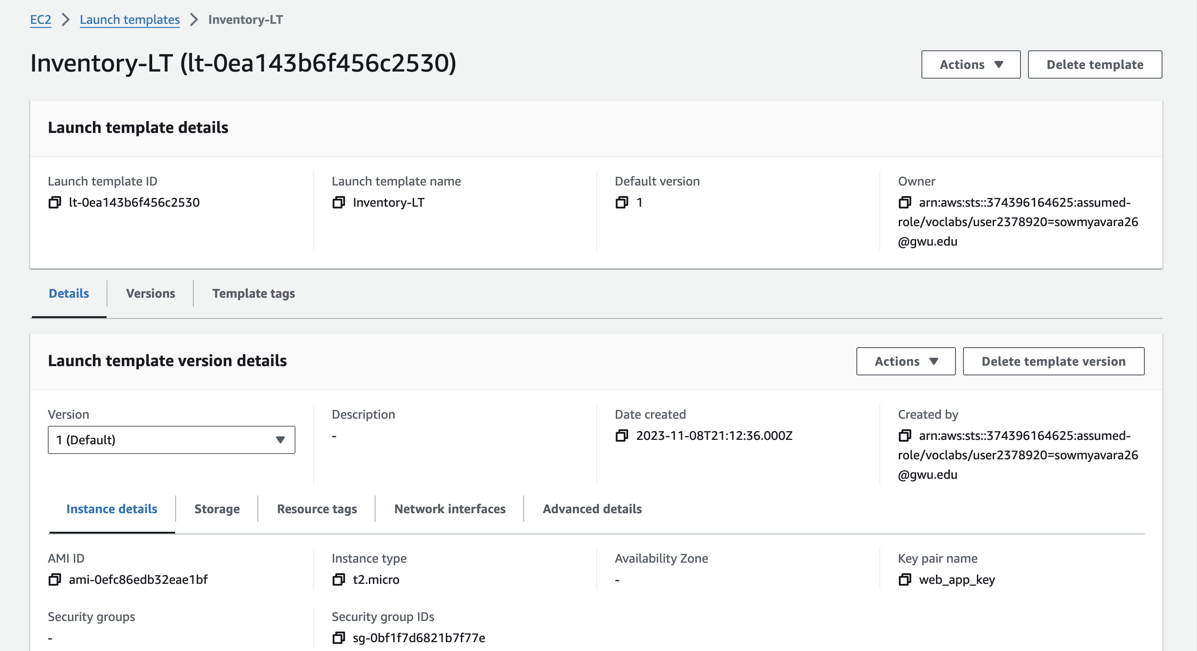
Creating Auto Scaling Group
Create a Launch Template. When you create a launch template, you specify information for the instances such as the AMI, the instance type, a key pair, and security group.

Slide 49
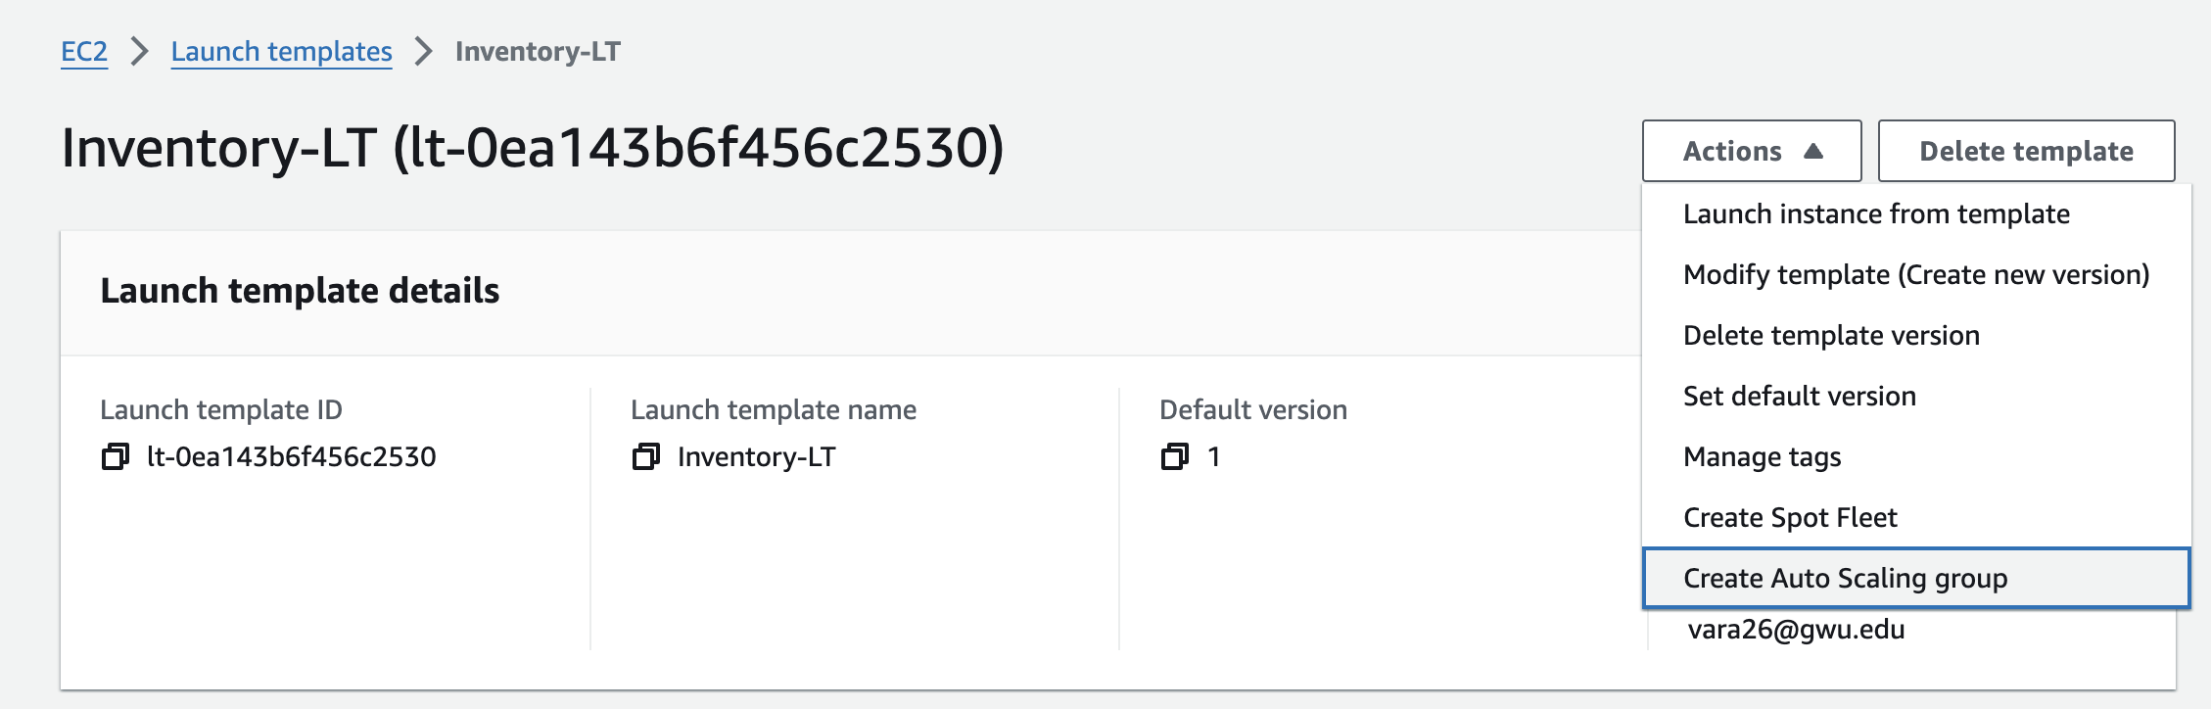
Creating Auto Scaling Group
After creating Launch Template, Click on actions and then choose Create Auto Scaling group

Slide 50
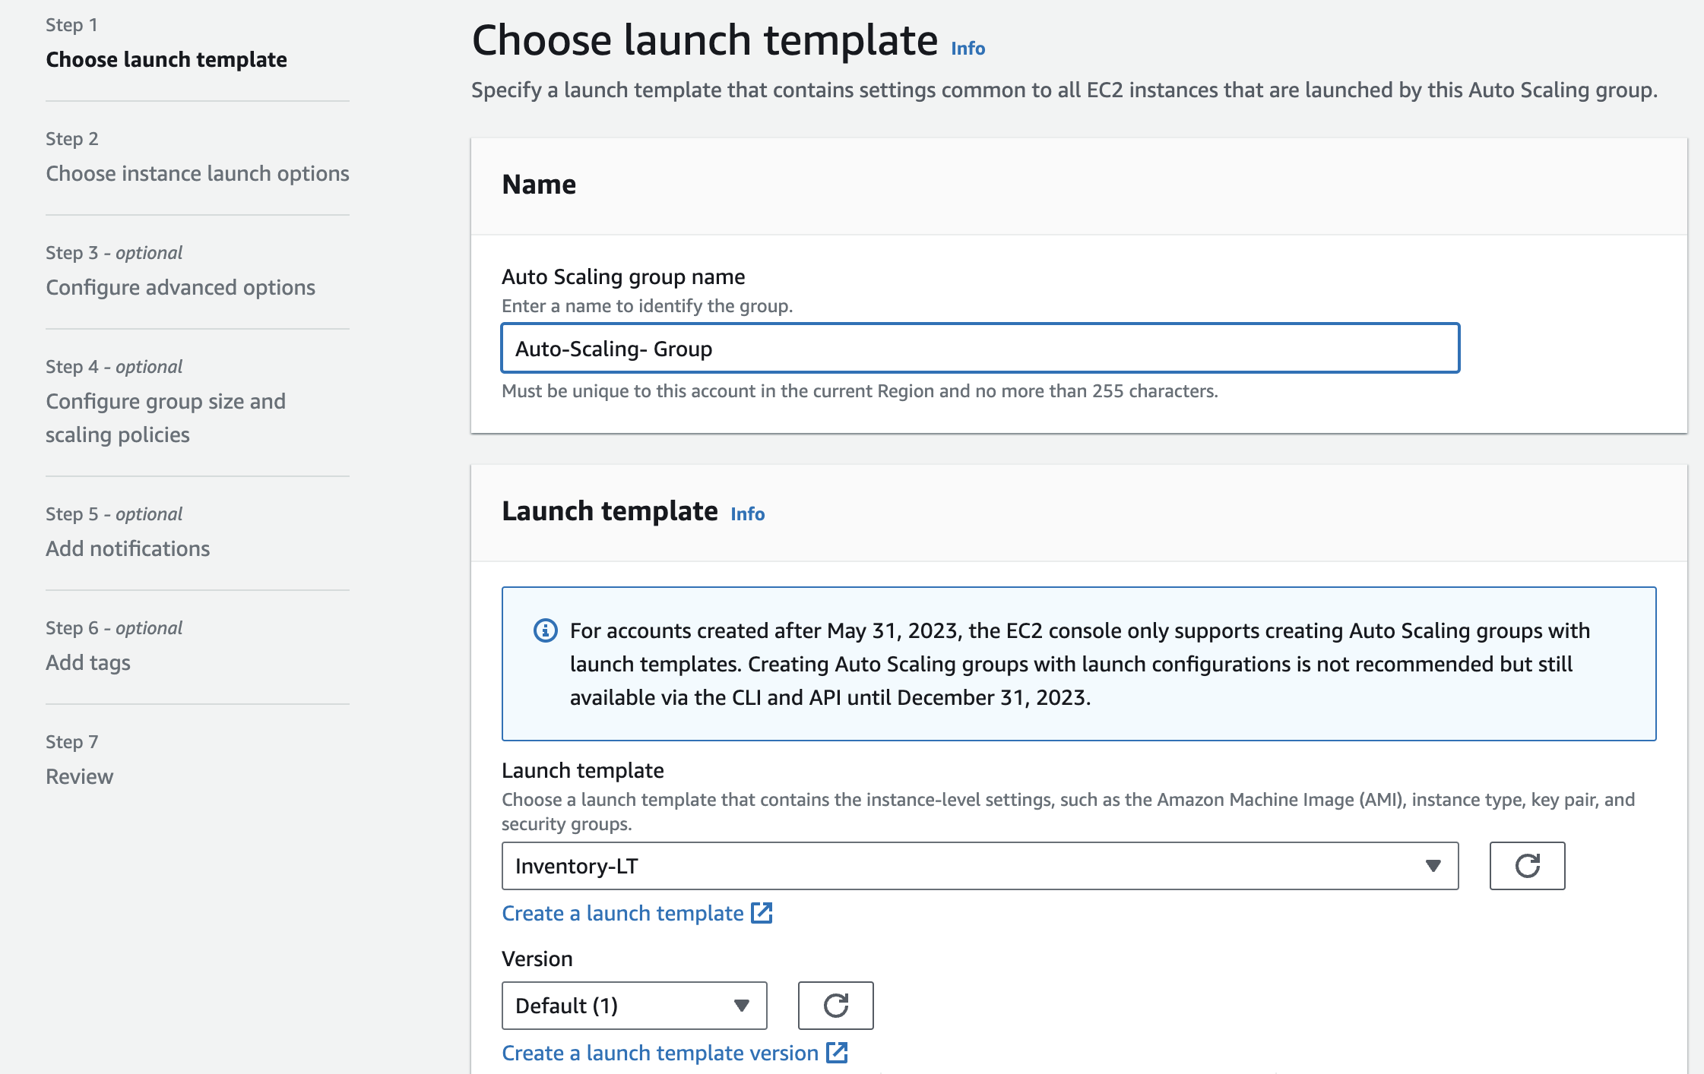
Creating Auto Scaling Group
Step - 1

Slide 51
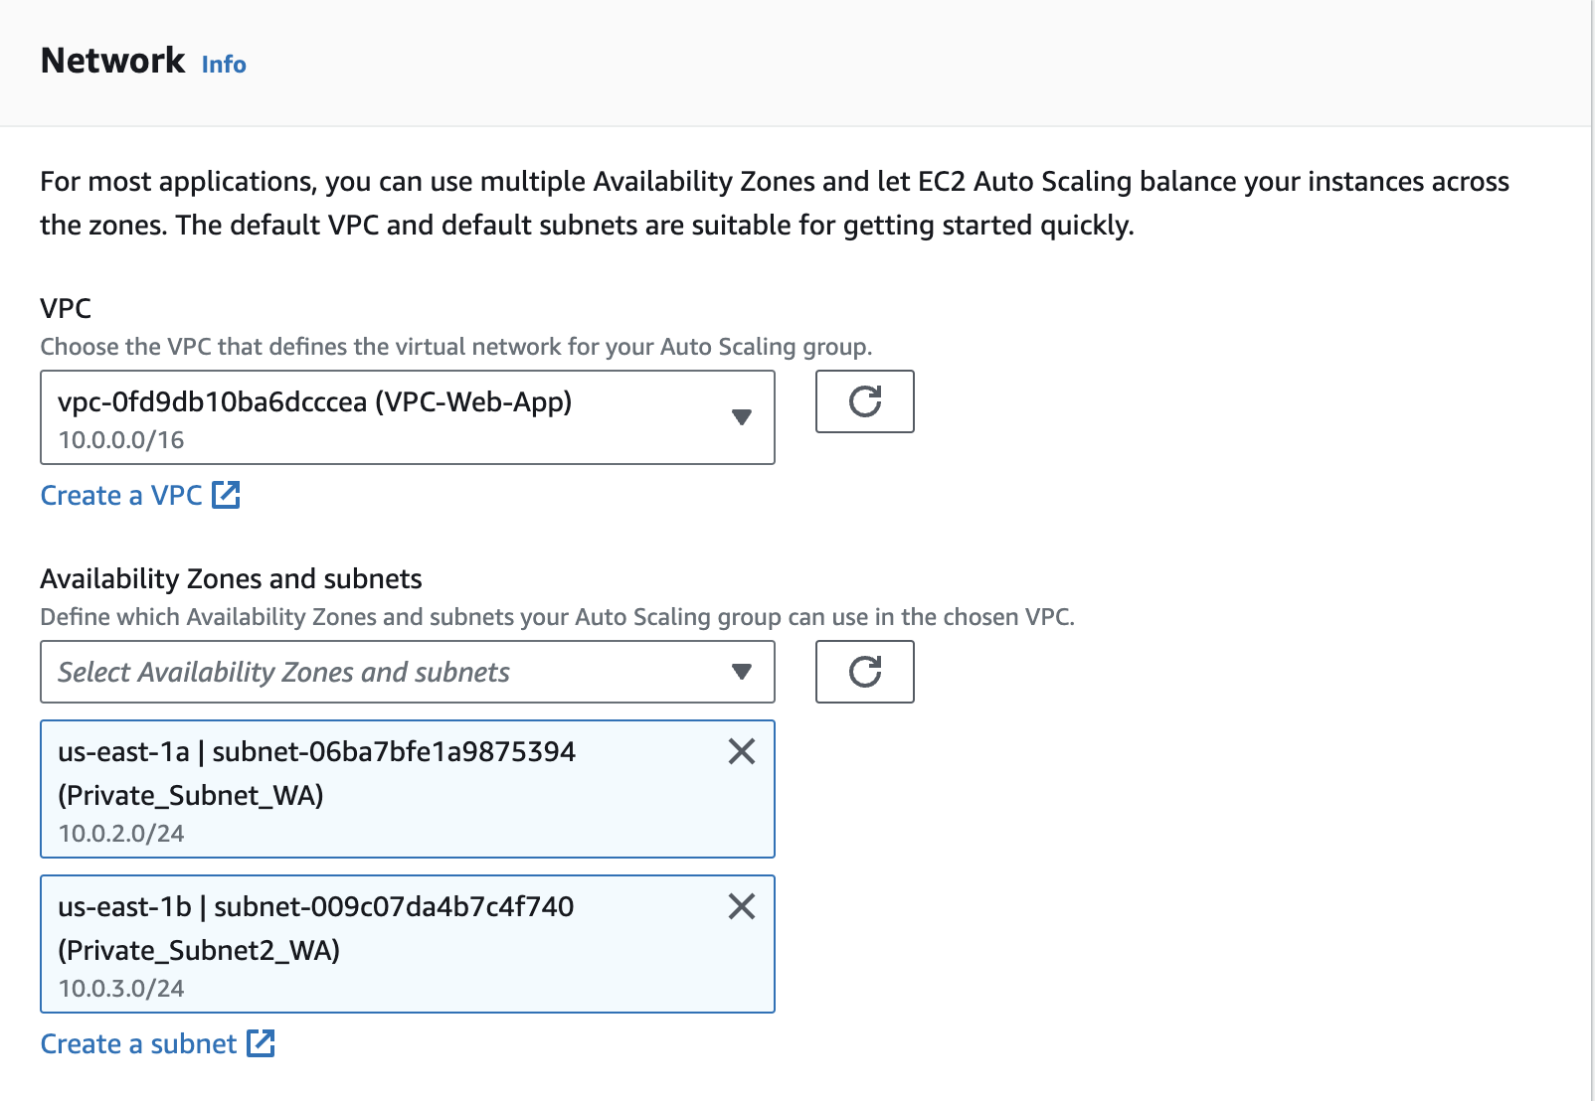
Step - 2
Choose your VPC and for Availability zones and Subnets
Choose Private Subnet 1 and then choose Private Subnet 2. This will launch EC2 instances in private subnets across both Availability Zones.

Slide 52
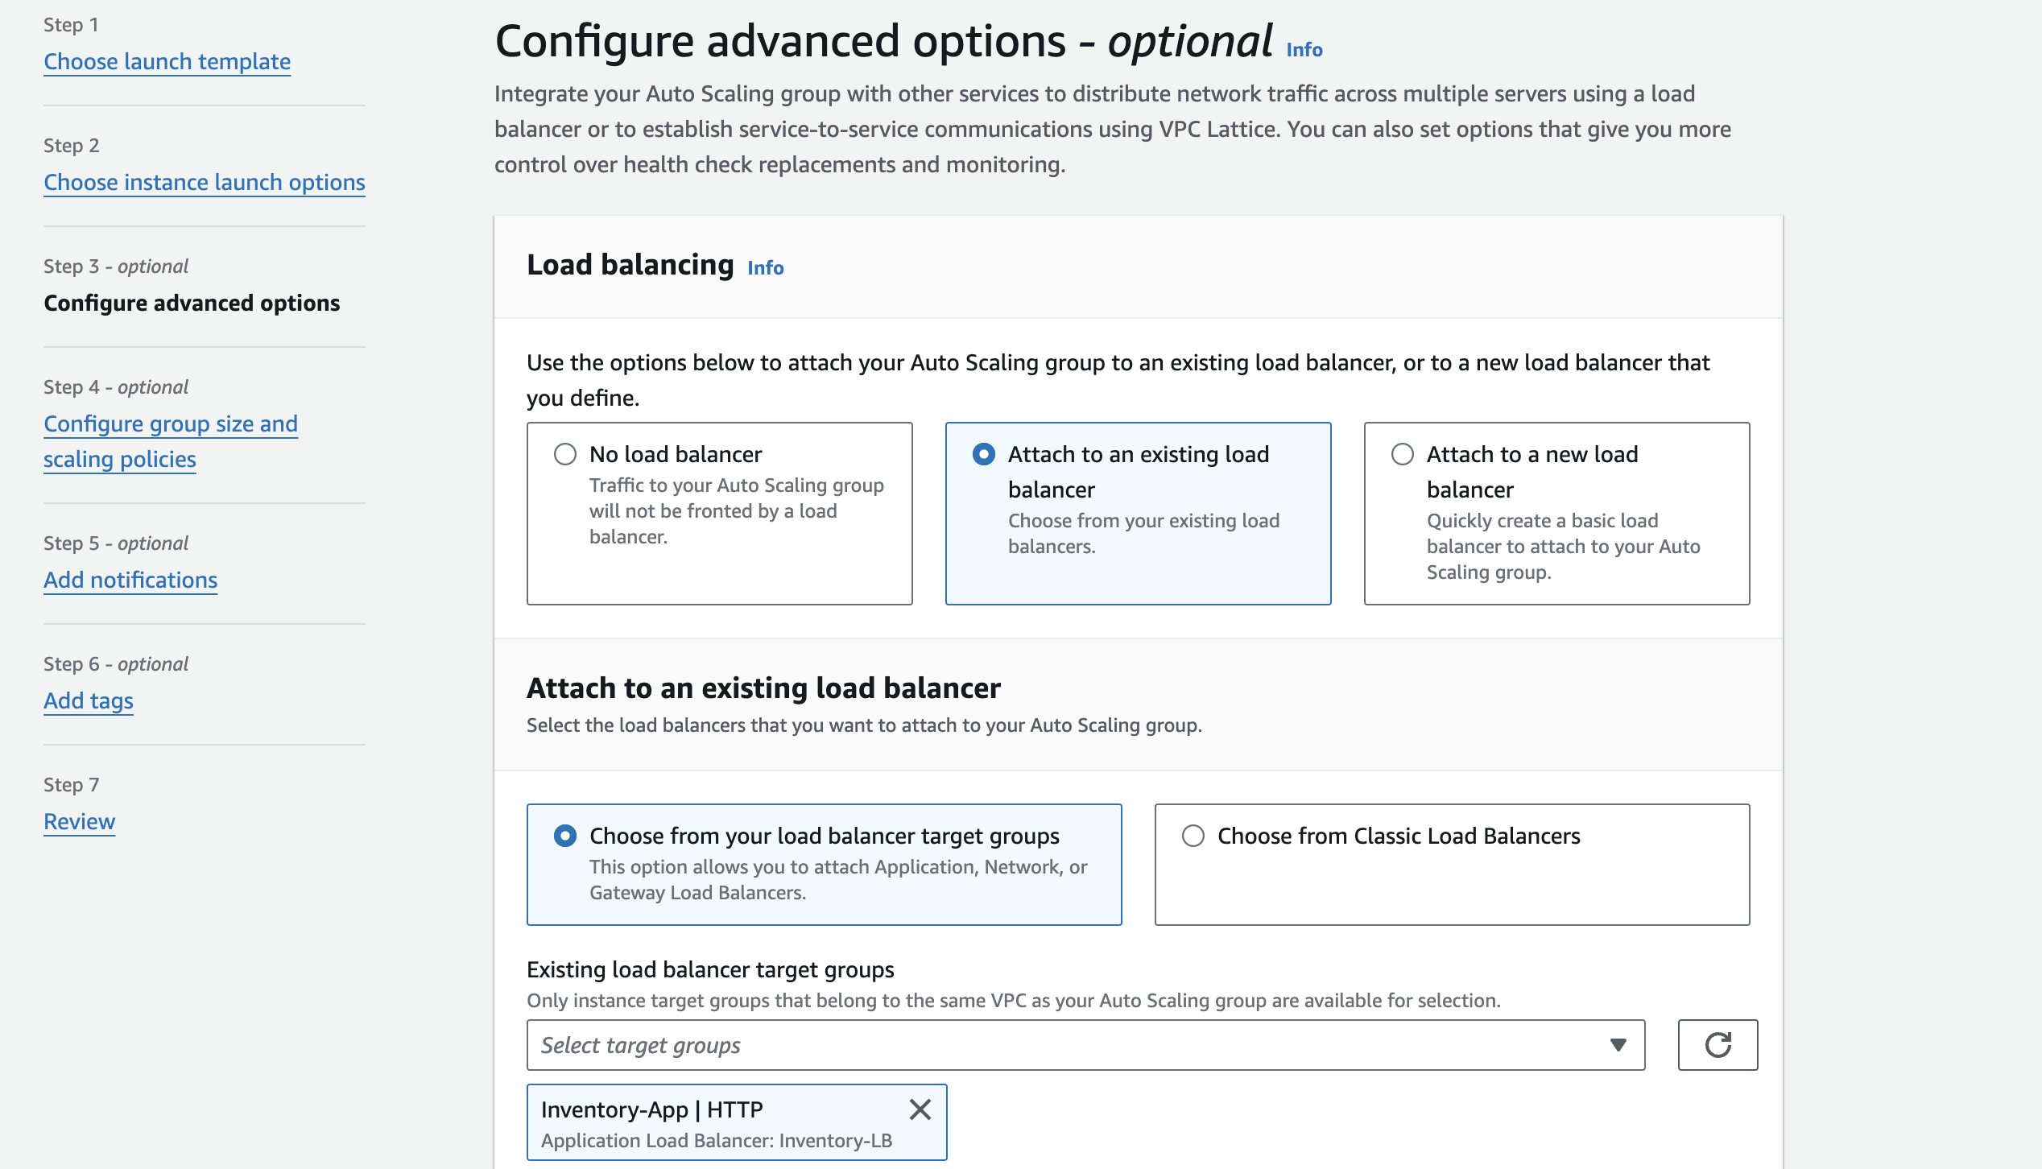
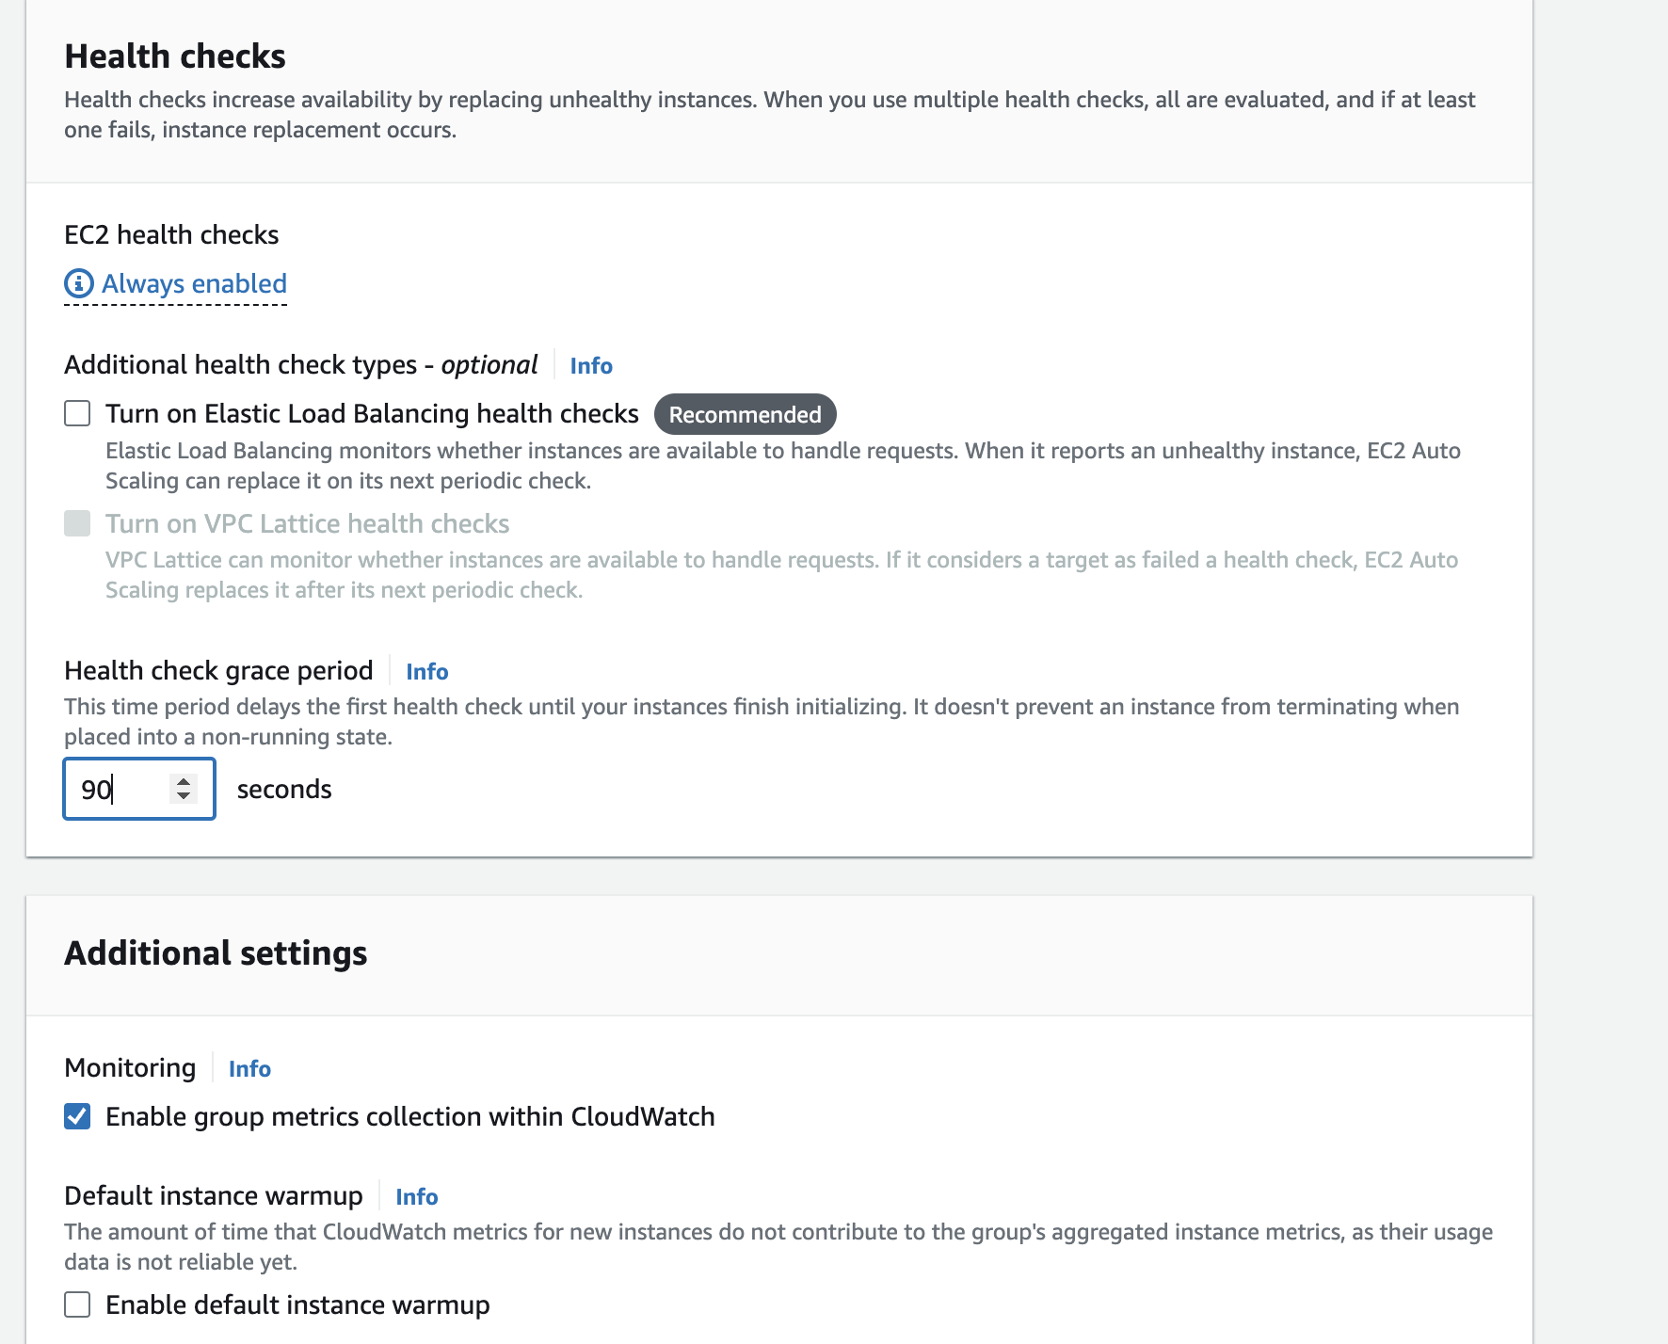
Step - 3

Slide 53
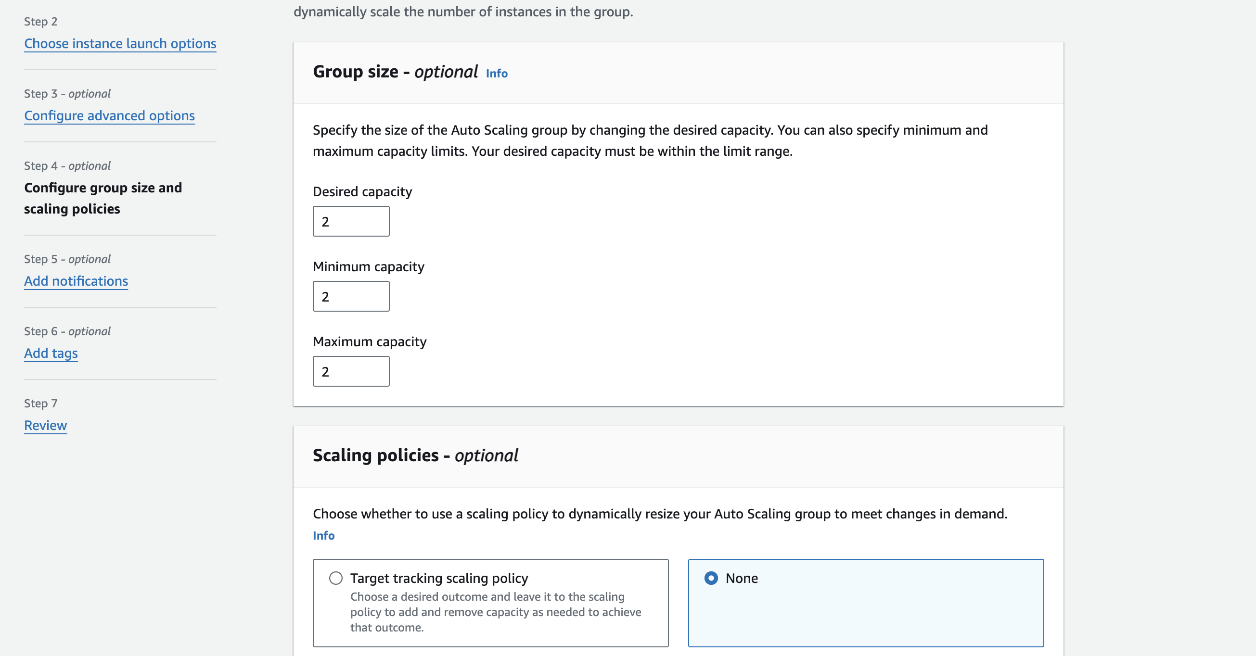
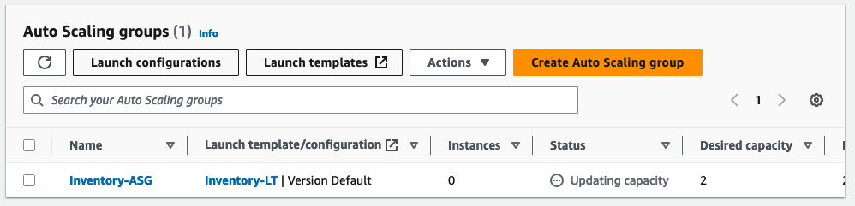
Step - 4
After a minute, choose the refresh icon to update the display. It should show that 2 instances are running.

Slide 54
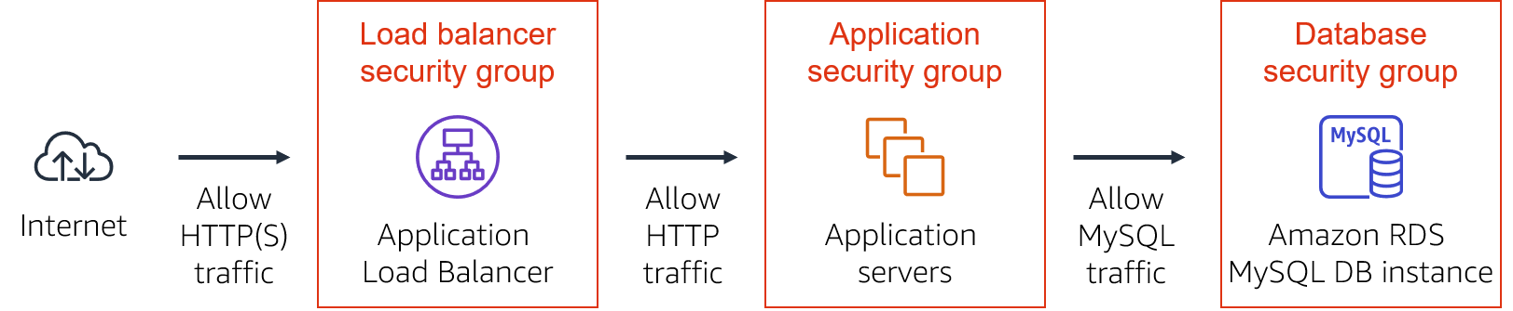
The application you deployed is a three-tier architecture. You will now configure the security groups to enforce these tiers:
Update your Application Security Group
Security Groups > Inventory-App > Inbound Rules
Type: HTTP
Source:
Choose the search box to the right of Custom
Delete the current contents
Enter sg
From the list that appears, select Inventory-LB
Description: Traffic from load balancer
Choose Save rules
The application servers can now receive traffic from the load balancer. This includes health checks that the load balancer performs automatically.
Update your Database Security Group
Security Groups > Inventory-DB > Inbound Rules
Delete the existing rule.
Choose Add rule.
For Type, choose MYSQL/Aurora
Choose the search box to the right of Custom
Enter sg
From the list that appears, select Inventory-App
Description: Traffic from application servers
Choose Save rules
You have now configured three-tier security. Each element in the tier only accepts traffic from the tier above.

Slide 55
Phase 4: Implementing high availability and scalability
Task 3: Accessing the application
Access the application and perform a few tasks to test it. For example, view, add, delete, and modify student records.

Slide 56
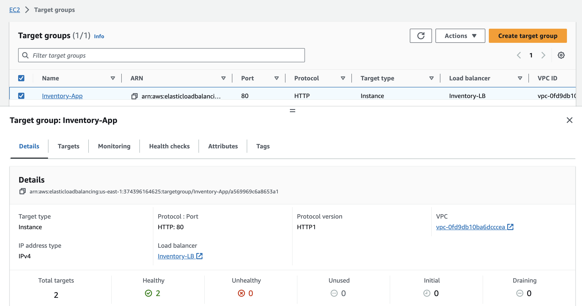
Testing the Application
In Target Groups, click on the target group you crated and in the details tab, two registered targets status must show as Healthy.
The Health status column shows the results of the load balancer health check that is performed against the instances.

Slide 57
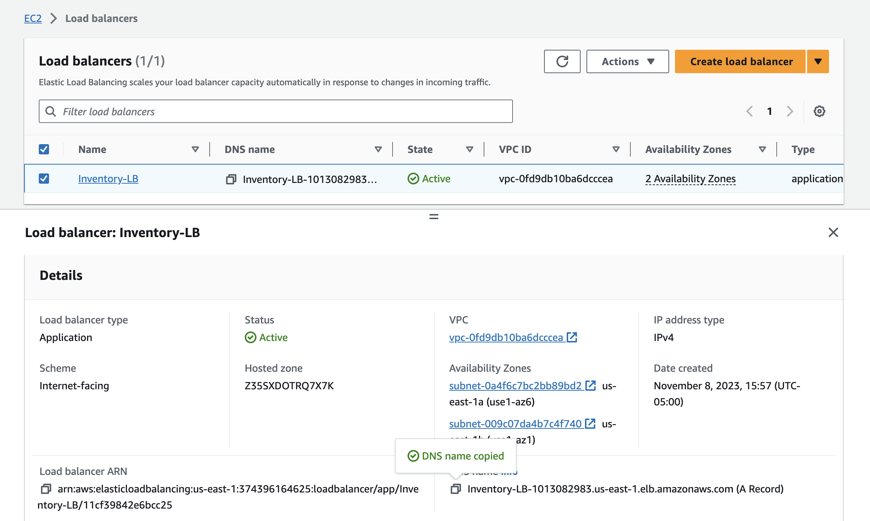
Testing the Application
Go to your EC2 instance and then Load balancer.
In load balancer details tab copy the DNS name.

Slide 58
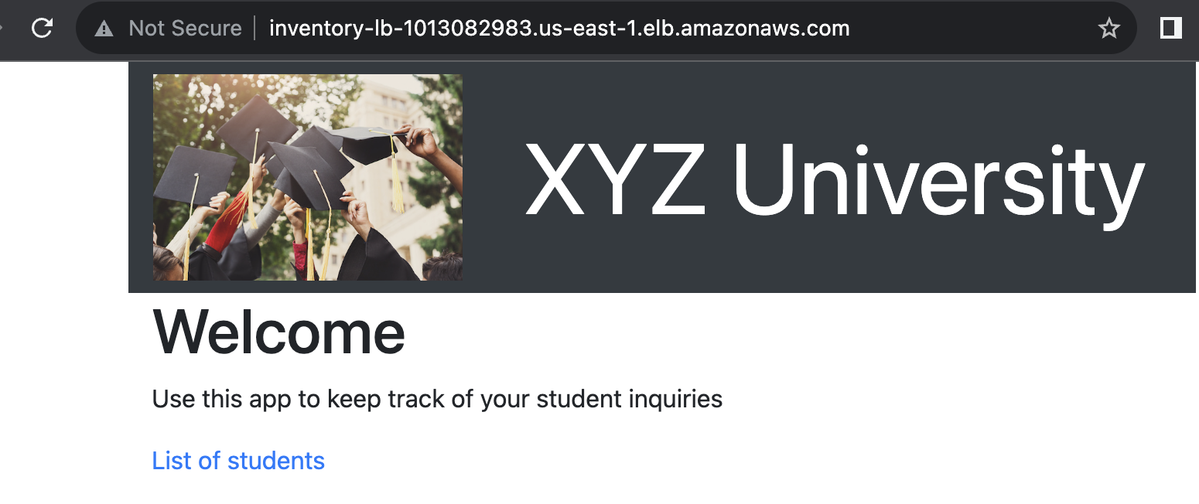
Testing the Application
Open a new web browser tab, paste the DNS name from your clipboard and press ENTER.
The load balancer forwarded your request to one of the EC2 instances.
Reload the page in your web browser. You should notice that the instance ID and Availability Zone sometimes toggles between the two instances.

Slide 59
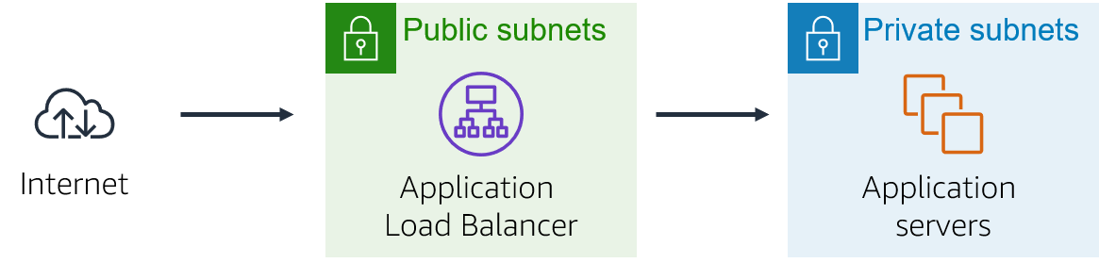
When this web application displays, the flow of data over the network is shown above.
You sent the request to the load balancer, which resides in the public subnets that are connected to the internet.
The load balancer chose one of the EC2 instances that reside in the private subnets and forwarded the request to it.
The EC2 instance then returned the webpage content to the load balancer, which returned it to your web browser.

Slide 60
Phase 4: Implementing high availability and scalability
Task 4: Load testing the application
Perform a load test on the application to monitor scaling.
Use Script-2 from the AWS Cloud9 Scripts file (cloud9-scripts.yml) to perform the load test. Recall that you used scripts from this file in previous tasks.
Notes:
Access the web application from the browser by using the load balancer URL.
Use AWS Cloud9 to run the load testing scripts against the load balancer.
Reference
loadtest Tool Repository on GitHub

Slide 61
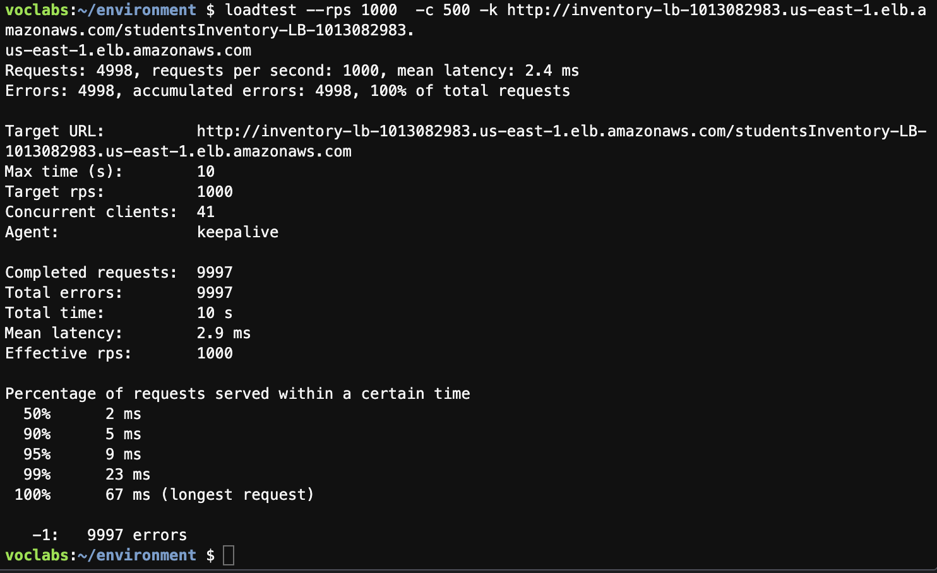
Testing the application in Cloud9
On running the Script-2 for load testing using load balancer DNS
Script - 2
## Load testing
#Following command installs #loadtest package to perform load testing on the application
#Prerequisites are mentioned in the resources section
npm install -g loadtest
#Following command performs load testing on the given URL. replace the URL with Loadbalancer (or Public IP of EC2 instance)
# Press ctrl +C to stop the script
loadtest --rps 1000 -c 500 -k <<ELB URL>>
Please go through this link for more details: https://github.com/alexfernandez/loadtest

Slide 62
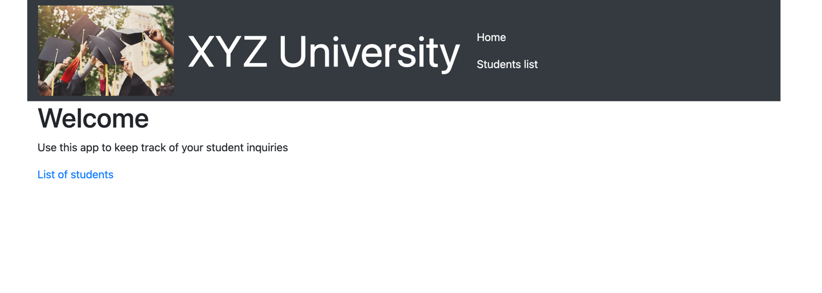
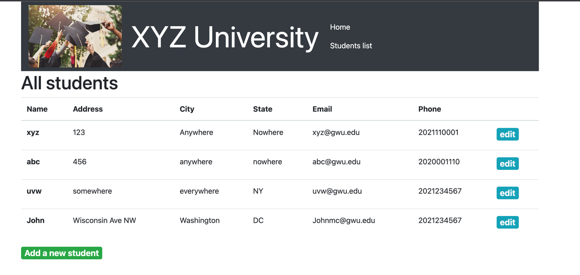
Web Application

Slide 63
Thank you.

